Slide 1
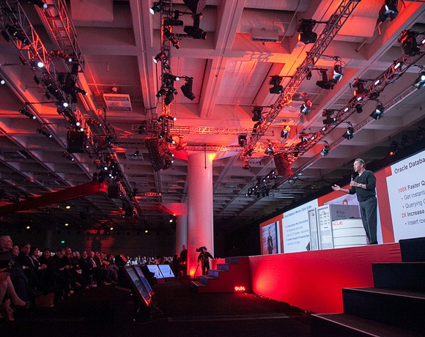

Database as a Service
Presented to
BCS Edinburgh Branch
David Martin
Enterprise Architect
Oracle Consulting, UK, Ireland, Israel
2nd September 2015
Notes:
Feel free to get in touch if you have questions!
David.M.Martin@oracle.com
01506 673 806

Slide 2

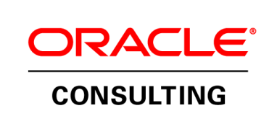









A bit about me
RSTS/E on DEC PDP/11
IBM 370
First IBM PC
3-node office automation LAN (in 1984!)
Novell Netware CNE (#64)
Sun SPARCstation 1 (20 MHz , 48MB RAM)
Cisco 2501
Broke a demo Gen 1 NeXT cube
Oracle Database 8 for OS/390
Oracle Database 8i (Sun E250)
Recovered hard drives from 200 Vesey St. in Sept. 2001
Developed “Building Blocks” (2007)
Joined Oracle 2011
Notes:
Been around a long time
Was working IBM 370 terminals when PC was announced
Before that I Worked in aircraft, family friend was IBM sales person – 1 MF year quota
He connected me with someone if IBM HR and they laughed
I decided to go to uni, programmed in RSTS/E, hated programming, wanted to play with the hardware
Hope you don’t mind that didn’t open with a joke? NeXT cube. Broke early working model. Tim Berners-Lee is said to have written WWW on a NeXT. I doubt if it is the same one- but sometimes wonder if I delayed the invention of the WWW.
Building blocks in 2007 would now be described as IaaS
First citation of DBaaS was late 2010 at mit.edu

Slide 3
BIG
Numbers
Notes:
Why is DBaaS discussed.
Recently discussions (<18-mos) of DBaaS are now crudely lumped into the technology context called Cloud; Public vs. Private
At the risk of muddling things- I’ve not done much distinction with DBaaS as it can be either public or private (aka on-premise)
And … the important thing to define (and achieve) DBaaS are IT activities that lead to delivering business objectives.
Numbers on the next few slides are from a Gartner 2014 report.

Slide 4
Enterprise Customer Plans
74%
of enterprises are pursuing cloud strategies
Notes:
In the study “cloud” includes SaaS, PaaS and IaaS.

Slide 5
Market predicted to grow at 29.1% CAGR
$16.5 Billion
Global Spend in 2015; Increase of 32.8% from 2014
Global PaaS market to grow to $4.1B in 2015
Notes:
Cloud spend on “x as a Service”
CAGR = Combined Annual Growth Rate = mean growth rate over >1-year

Slide 6
All Signs Point to PaaS Growth in EMEA
$3 Billion
Gartner estimated EMEA PaaS spending in 2015
42%
Of W. Europe IT buyers planned to adopt PaaS in 2014. Additional 21% said they would develop plans in 2015
Up to 7x
PaaS growth rates in EMEA are faster than overall market growth rates!
17% vs. 4.7%
Growth of PaaS vs. On-Premise EMEA CAGR 2014-2018
Notes:
These are US Dollars! So, what’s happening in Europe?
“Up to 7x” EMEA is growing faster than the rest of the world
Public growing faster than on-premise

Slide 7
Database – All Signs Point to the Cloud
$1.8 Billion
Estimated DB Cloud market size in 2016
86%
CAGR for public DB Clouds (2012-2016)
#1
DBaaS Fastest growing PaaS over the next 5 years
52%
Of businesses will adopt public DB Clouds by 2016
Notes:
Of PaaS – Database is growing faster than anything else and expected to be over next 5-years
Early doors.

Slide 8
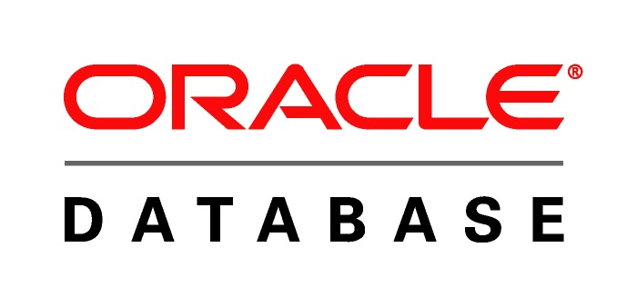
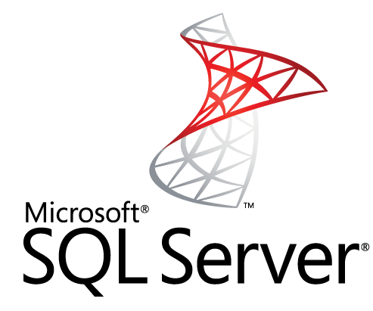
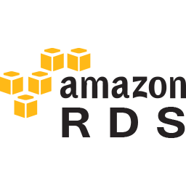

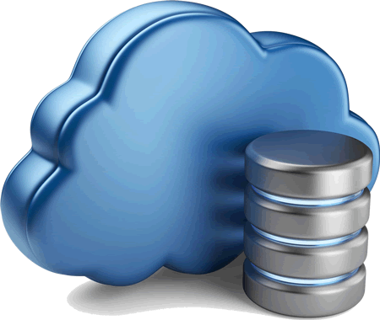
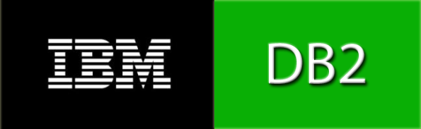
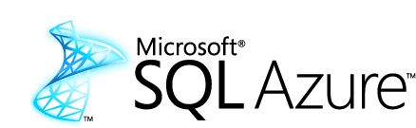
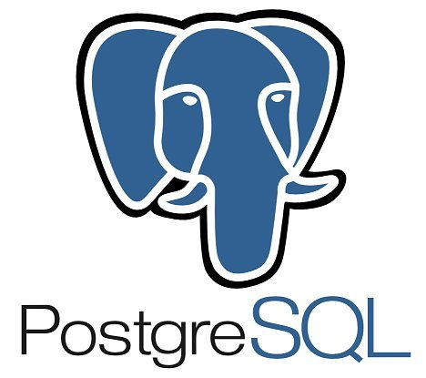


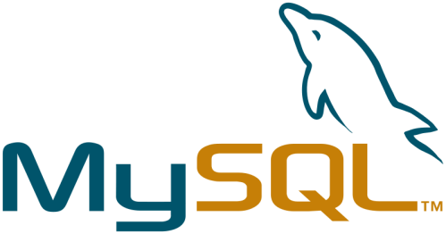
What is DBaaS?
Notes:
Cloud deployments = yes
Oracle and MSSQL = yeah
Others = yeah
All = maybe
All? = not for sure
I’ll spend the rest of the hour explaining why I don’t think this stuff is DBaaS!

Slide 9
Database as a Service
Key Drivers
Reduce Cost
Increase Agility
Database as a Service
Reduce Risk
Improve Service
Notes:
Before we ask what – Lets ask why
You don’t deploy technology for the sake of technology – you work in organizations/businesses and DBaaS has to have a purpose!

Slide 10
What is DBaaS?
Standardisation
Consolidation
Database as a Service
Optimisation
Automation
Notes:
So … Ok … What is it?
(and How do I do it?)
Talk about each aspect on its own slide.

Slide 11
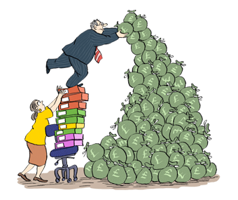

Standardisation
Can you run a Zoo?
 | 8 | 9i | 10gR1 | 10gR2 | 11gR1 | 11gR2
Tru64 5.0 | 99 | 34
Tru64 5.1 |  | 114 | 58
Tru64 5.1B |  |  | 86
AIX 5 | 7 | 110 | 11
AIX 6 |  |  | 71 | 165 | 64
AIX 7 |  |  |  |  | 18 | 21
Linux 4 |  | 3
Linux 5 |  |  |  | 1
Linux 6 |  |  |  |  |  | 1
3 O/S Families
6 Major Database Releases
5 of 9 OS Versions out of primary support
5 of 6 Database Releases are Out of Extended Support
Notes:
This is a real customer with real data on their estate
READ the data in circle
Very typical of larger organisations, some old, not a lot of new
BUILD 1: Care and feeding of all the variations is like feeding at a zoo. Few animals eat the same thing nor at the same time.
BUILD 2: Why is variety a problem: Cost

Slide 12
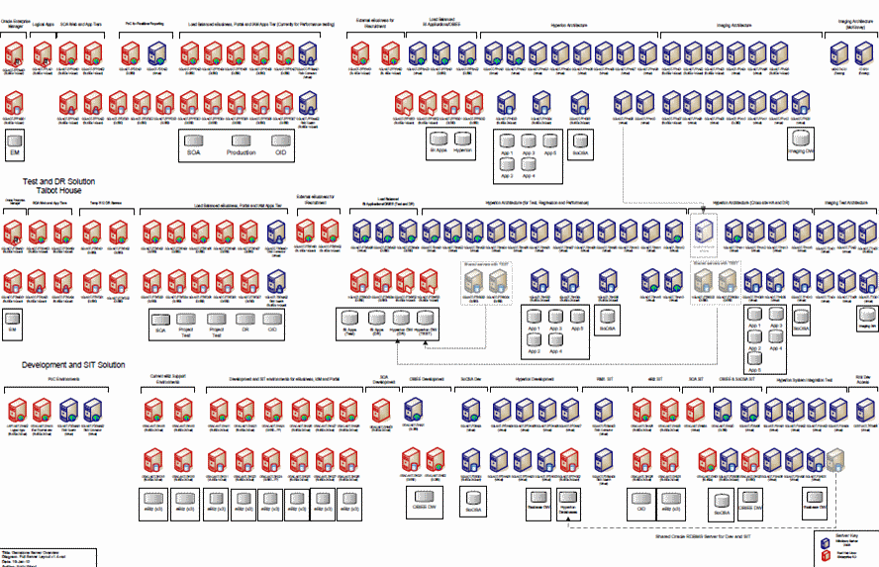

Consolidation and Optimisation
Notes:
Applicable primarily to PRIVATE DBaaS CLOUD
Same real customer, power savings alone were huge
(Tru64) DEC/HP Alpha’s (come Itanium) are OLD!
They still buy parts off of e-Bay

Slide 13

Automation
51%
DBAs state dealing with manual tasks like provisioning & cloning of new databases for test/dev systems is too time consuming
“Provisioning a database server takes us 4-5 days with involvement of different groups to create a system meeting enterprise standards. Need to roll out services on short order in matter of minutes and hours”
Notes:
Every time you put a person behind a keyboard there will be differences.
Every time one of those people walk away from the keyboard- things can stop

Slide 14
Continuous Evolution
Standardise
Consolidate
Optimise
Automate
Notes:
Standardisation makes consolidation simpler,
Optimisation easier,
Automation possible,
Leading to more standardisation.
Will mention an approach to this later

Slide 15
Standardise
Aggressive simplification
Standardise
Minimal set of database versions
Standard architecture
Well defined service catalogue
Standard maintenance processes
Standardise monitoring & reporting
Well defined user interface
Lower operational cost
Notes:
Emphasise aggressive!
This is the foundation of DBaaS
DBaaS is about achieving scale
Standard process and reporting on everything lower costs
The first step of any IT process does not have to be “lets see what’s there”

Slide 16
Consolidate
Large scale consolidation onto a modern shared platform
Consolidate
Higher density of databases on hardware
Reduced hardware requirement
Consolidate use of licenses
Minimise test and development systems
Share acceptance test resources
Reduce number of OS/DB installations
Lower capital cost
Notes:
Older estates almost always have old server.
Moore’s law (for CPU) is true.
I couldn’t find a Moore’s law for Storage but I have a 32GB SD card in my phone.
Standard server hard drives are often 4TB
You can sweat the assets.
Why? Licensing is by core whether it’s fast or slow so a huge Capex cost. But, don’t forget that power and cooling savings will probably yield positive ROI

Slide 17
Optimise
Improve every aspect of the service
Optimise
Hardware optimised for database
Database pools optimised for license
Optimised DBaaS processes
Enforce security to minimise risk
Improved resilience
Differentiated service models
Lower OpEx Cost, Faster Deployment
Notes:
Pick the right server, right storage and don’t pay for too much.
Don’t treat all DBs like platinum – there is a balance but can you afford to build a bronze service a platinum solution?
But look at *EVERY* aspect! Processes without unnecessary steps are good
Make sure that all the requisite steps are in the process – revisit them. Get rid of aye been- It will pay off.

Slide 18
Automate
Convert manual processes into automatic or self-service
Automate
High automation of common operations
Self-service interface
Auto space allocation
Pro-active monitoring
Automating regular patching
Automated service upgrade
Lower OpEx Cost, Faster Deployment
Notes:
Automation is key for standardisation
Beyond deployment but including Self service –Challenge the status quo! Why wouldn’t it work for Dev/Test?
Cloud methodologies enable your users to deploy a small databases without your involvement. People come to expect this.
You can bet the Cloud providers (like Oracle) have automated, self-service provisioning! Why can’t you?
Just make sure you expire a self service DB (or get a credit card ☺)
Your big critical services are NOT targets for self service but dev/test- why not
Reporting is key to capacity enabling self service. Self service is an important reason reporting is essential.

Slide 19
DBaaS
The Key Principles
The approach must :
  allow gradual transition – no big bang
  allow evolution of the service
  deliver cost-optimised levels of service
  drive simplicity and standardisation
  break the link between an application and specific hardware
  allow transparent service migration
  Enable self-service
The approach must not
  lock into specific vendor hardware or storage
Notes:
The road to DBaaS is gradual. It is hard.
Utilise Agile methods. It’s pervasive – it is evolution
Break the link between complex systems of bespoke hardware and database and application unless there is genuine reason.
As long as data comes back on port 1521 why does the user care whether their Oracle Database runs on Linux, or Z/OS, or SOLARIS, or even Windows?

Slide 20






Service Catalogue Overview
Business Catalog
Self-service Catalog
  What does the service provide
    Service levels and costs
    Should fit on one page
    Hide deployment complexity
  On demand portal of selected items from the Business Catalog
  Exception Handling
  Criteria for identification
--------
--------
--------
--------
--------
--------
--------
--------
--------
  Custom build to requirements
  Custom pricing
Technical Catalog
  How is the service provisioned and maintained
    Deployment template
    Processes
Notes:
The most fundamental piece of DBaaS design is the service catalogue
Much more important than the server or storage
It describes IT in business language.
My phone example again – 4-cores. My laptop has two, my desktop at home has 4.
Business people don’t know what a core is.
It should drive the selection of server and storage
Handle 90% in the catalog, 10% (or less) with the exception process.

Slide 21
Differentiated Service Levels
Delivering service, driving out cost
Bronze
Silver
Gold
Platinum
Increasing resilience, availability, scalability, performance
Decreasing cost to deliver
Notes:
Describe your services with a name that helps make differences obvious
Of course here we are talking about service levels
We STRONGLY recommend differentiating service levels by availability.
Customers know what 24x7 means – they don’t have a clue what a terabyte is.
Don’t sell them a core (my phone has 4) nor GBs of RAM
We’ll address the performance implications with POD scale out (or scale up if genuinely required)

Slide 22
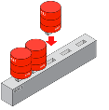



Guiding the Service Catalogue Design Process
Business Catalogue
Technical Catalogue
Self-Service Catalogue
Deployment Model
Defined service tiers to simplify business offerings
Establish the technical footprint of each service tier
Determine the individual services to be provisioned
Align services with your deployment model
Bronze
Silver
Gold
Platinum
RAC
Data Guard
Backups
Small
Large
Medium
X-Large
PDB Database Schema
Private
Public
Provider
Hybrid
Notes:
The process of building a service catalogue - These are the things IT needs to think about.
Your service offerings drive the technical catalogue
When I run these I hold workshops and analyse requirements with a SME in required domains (infrastructure, database).
Don’t keep this hidden from the customer but remember availability. They speak business you speak IT
As long as your designs meet the SLA/SLO they should not have a big say (unless you need their buy-in for budget and they’re sensible).
Business people are typically bad a making technology decisions.

Slide 23
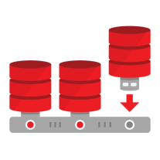












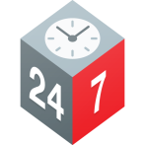



Architecture, Design and Roadmap for DBaaS
Business Requirements
Service Catalogue
Reporting and Showback
Backup and Archive
Availability and Recovery
Capabilities and Tooling
Security
100%
Monitoring and Health
Patch Management
Upgrade
Tenant Access
Admin Access
Notes:
In addition to all the stuff on the previous slide – there are lots of essential items to consider.

Slide 24






Where is DBaaS?
Public vs. Private
Notes:
These are different! Could be same technology but have different characteristics
I don’t spend a lot of time tonight talking about hybrid. But it’s something you’ll all probably have to deal with.

Slide 25
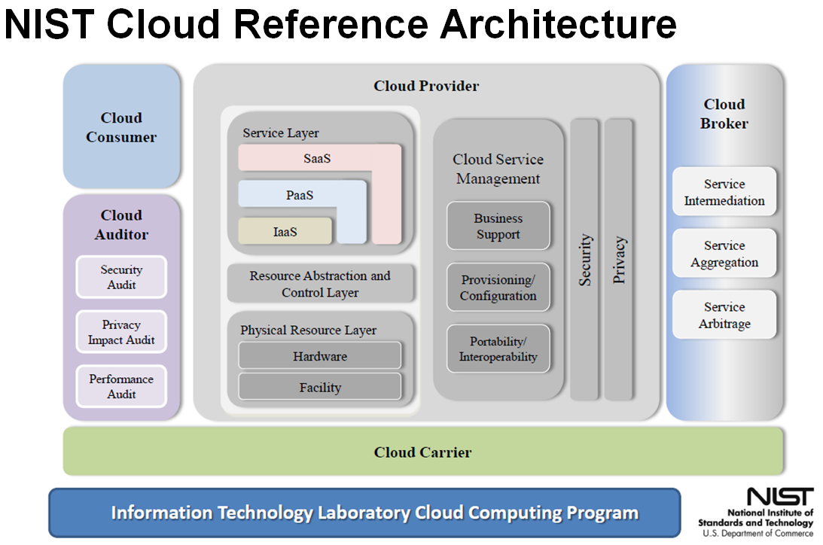
This is a Fork in the Road
Notes:
This slide builds!
Talk about components, services
THEN BUILD: The difference between public and private is “who is the provider”

Slide 26
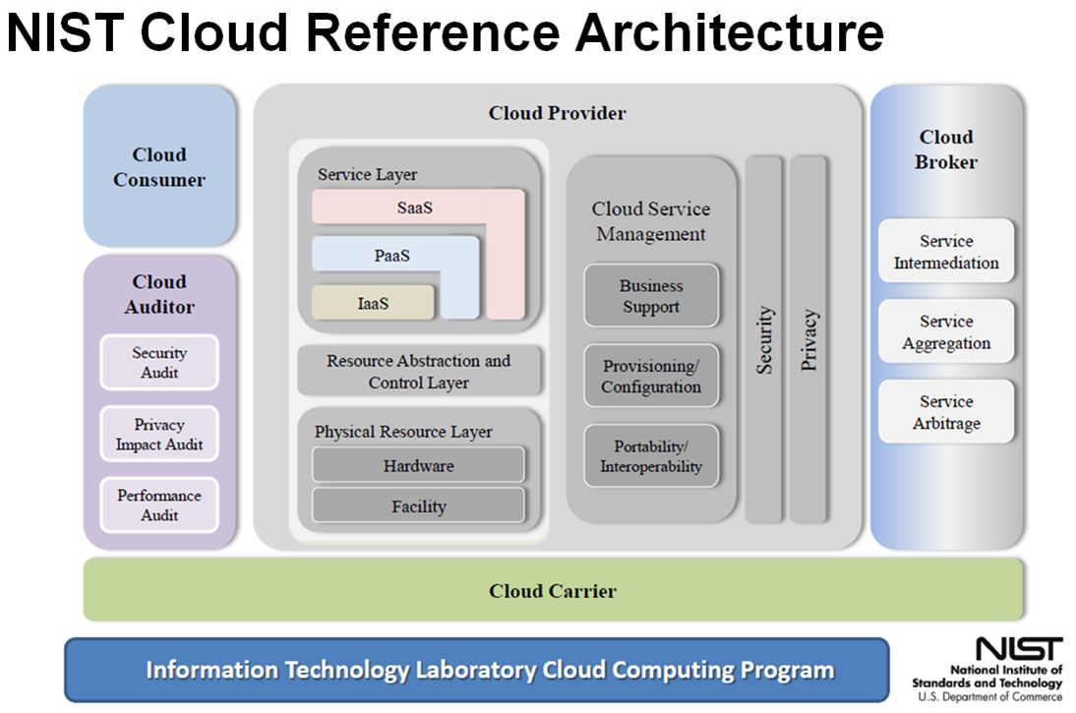
Public vs. Private
?
Notes:
Talk about the x’s
Public does not have infrastructure you manage – someone else does – that’s why it is popular.
But do you think your Azure service runs on Linux –or- your Oracle DBaaS on Windows?
Amazon run’s Oracle on either.
Installing servers and setting up databases is time consuming
Steve Coleman’s, energy company story:
666
6 months for server and storage
6 weeks for databases
6 hours for cloud

Slide 27
Private Cloud DBaaS
Notes:
Some services *will* require private.
Sensitive data
Data sovergnity
There will be a need for private. Don’t be daft.
We’ll Talk about “Private” “On-premise first” then “Public”

Slide 28
So, what’s the key ?
Simple standard building block
Use small building blocks to build the database capability
Each building block offers a unit of database capability
  … nothing more, nothing less
Each building block can house multiple databases
Each building block offers a well defined SLA
Building blocks can be bolted together to provide ;
  Higher Resilience
  Elastic Scalability
Notes:
Building blocks is a well understood deployment model and ideally suited for DBaaS
Different sizes and shapes of building block provide differing levels of availability, of SLAs
I’m going to talk about a number of characteristics and functions that are intertwined – Think about that circle that notion that actions lead to and enable the next action to be better

Slide 29
Database Unit : PoD
Encapsulating and abstracting infrastructure
Compute
Memory
Network
Storage
Resilient
Multi-database
Single DB Version
Multi-server
Resource Managed
Cost Allocation
Notes:
Spend a moment on this slide. Skip through next 2 slides quickly
I want you to think about the platform for DBaaS as a POD.
Architecturally this is a POD – a Pool Of Database
An expandable unit of computing
Mention attributes on right column
Make them Resilient!
Make a POD consist of multiple servers, replicated storage
Multi-DB – keep things simple, single ORACLE_HOME
Bonded networks (LAN for sure. SAN if got but NAS seems to be winning in DBaaS)
Capacity/ resource monitoring and reporting is essential because you will have more than one

Slide 30
Self-Contained Building Blocks
Component based design
The database unit must contain everything required for the core database service
  Compute
  Storage
  Networking
  Memory
Backup is externally controlled as an independent service
  To be a valid backup, it must by definition, be external to the PoD
Overall service resilience is delivered through multiple independent PoDs across two more more sites or locations
Notes:
The key point on this slide is Backup!
A POD has everything required, they will be replicated, that’s essential for the recommended patching and upgrades we'
BUT …
Backup capability must be external to the pod, think offsite tapes. You won’t have a media server in every POD!

Slide 31
Database Unit : PoD
… as incremental units – basic building blocks of DBaaS
Compute
Memory
Network
Storage
Notes:
Don’t spend too much time here. The point is to connect PODs
This is how you should envisage POD deployments
Not one big monolithic unit. But cores *do* come in here and you may need “scale up” as well as “scale out” PODs
But all PODs must have resilience built in
NEXT SLIDE: are attributes

Slide 32
Connect PODs to Build Service
Scale-out Architecture
Some levels of the service are delivered by connecting together PoDs
Fail-over (aka fail-back) capability can be delivered across two PoDs to provide business continuity
Full site level disaster recovery is achieved by connected two PoDs across remote sites
Fail over and disaster recovery can be asynchronous for performance or can be synchronous for multi-site guaranteed zero data loss
Compute
Memory
Network
Storage
Notes:
PODs scale out, use bigger PODs to scale up
Think RAC high availability, same database accessible on different machines. Maybe Gold services need nodes in multiple PODs.
DR or Fail over/fail back across PODs in different data centres
Let the service catalogue drive DR (those availability) characteristics

Slide 33
Database Unit
Continuous Evolution … with backwards compatibility
Version 1
Version 2
Version 3
Year 1
Year 2
Year 3
  Core Capabilities
  Consumption Charging
  Self Service Provisioning
  New generation H/W & S/W
  Additional Automation
  Full Self Service Provisioning
  New generation H/W & S/W
Notes:
Use this approach to grow, to scale out, to add more databases to your DBaaS
Be agile, add services, additional service levels if needed. Maybe you don’t have clusters in Year 1!
The design of DBaaS must have a sound, robust foundational design but remembering that circle Standardisation -> Consolidation -> Optimisation -> Automation ->
Click on to next slide for more…

Slide 34
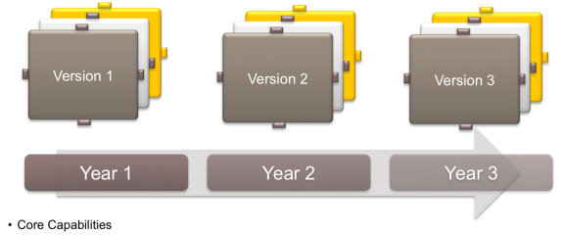
Designed for Evolution
Continuous Evolution
Each PoD is delivered as a working independent unit
New PoDs can include new versions of hardware and software
PoDs expose standard external APIs and interfaces across versions
No requirement to upgrade old PoDs
Deploy a PoD, run without major change until decommission
Optimises Return on Investment on assets
Avoids complex upgrades
Notes:
As pods are independent but similarly configured – evolution is enabled. You just move the service to a new POD since you’ve tested functionality
New features are enabled in next release on a different POD. Don’t upgrade a “live” POD. Deploy a new POD with new features.

Slide 35
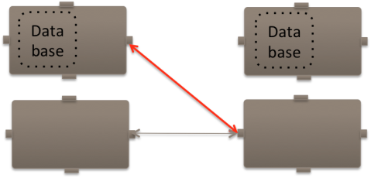
Upgrade through Relocation
Move to a PoD with the new version
Upgrade by moving the entire database to a new PoD
Facilitated by PoD ‘Point in Time’ clone copies & DataGuard
Copy the data, synchronise replica, switch primary & secondary
Enables near zero downtime upgrades
Optimise data copy process via rman
Database relocation capability also delivers service migration
Notes:
Be pretty quick with this slide. Next slide draws the picture.
Databases can be migrated. Many tools like clone-ing and Data Guard make it really easy
RAC, RAC One Node, target first – rolling patches built in are well documented
NEXT SLIDE IS PICTURE

Slide 36
Database Unit
Zero downtime upgrade
Database
Upgrade
&
Reuse
Upgrade
&
Reuse
Database
Current Version
Version + 1
Notes:
This slide has builds

Slide 37
Public Cloud DBaaS
Notes:
So … I’ve talked about private, what you need to consider if you’re *not* building on-premise

Slide 38
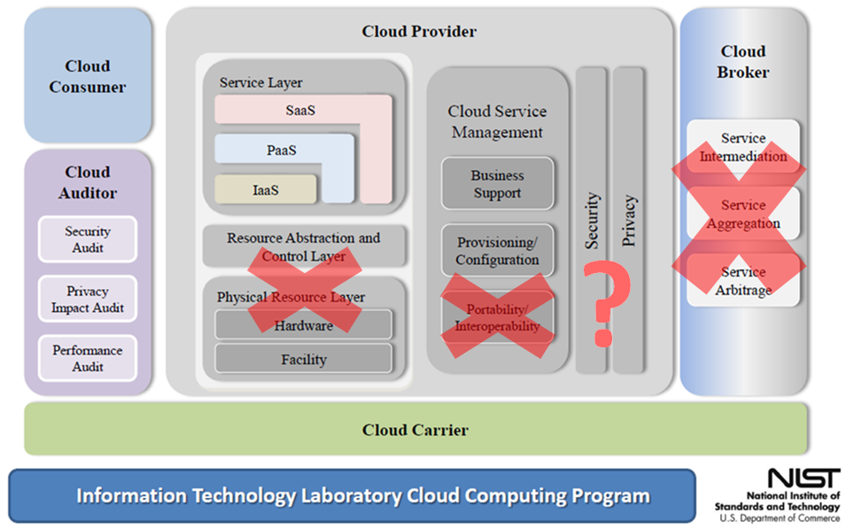
What Haven’t I Talked About?
Notes:
Be quick here. DBaaS is not always Public Cloud.
This slide draws out a couple of the distinctions.
Think back to that NIST architecture
Public Cloud looks different because there is less for you to think about – less you are able to leverage. In return you reply on your cloud provider to have considered that stuff.
You decision should be to select the right provider for your requirements
Certainly you have no infrastructure or resource abstraction to implement. With DBaaS, IaaS is different.
Portability and interoperability are not important because you either have them or you don’t
[Don’t necessarily go here if time is getting long] Some would argue that the role of Cloud Broker does not go away (as you still do it) but certainly it changes

Slide 39
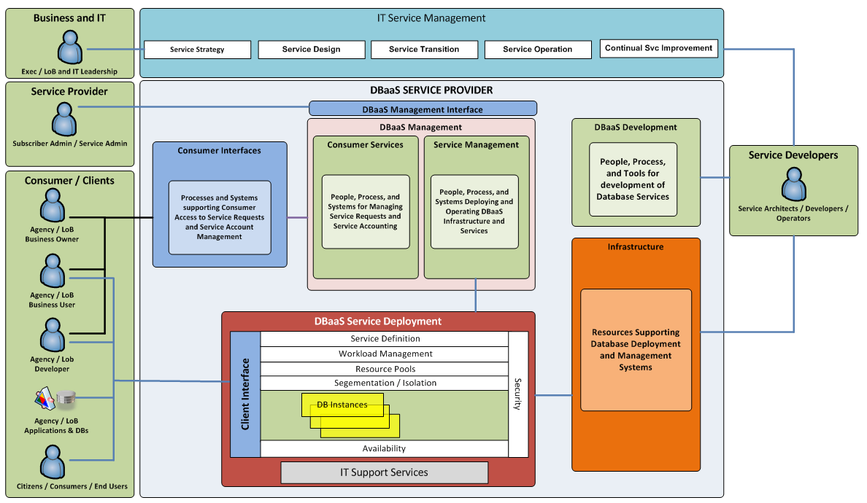
Different Perspective
Notes:
So the perspective, the architecture becomes conceptual.
(Don’t forget you’ll need to consider these aspects even if you are the cloud provider.)
For Public the focus shifts to how the service works. You abstract the lower layers and need to consider the interactions
You need to consider what are the services and operations that your business requires – You’ll have understood this in the service catalogue and designed accordingly.
There will be a service provider that needs to manage the estate – what do they provide (and what will you have to augment?)
Cloud consumers will interface with the “as a service” – what capabilities will you provide?
The deployment concepts? They are out of your ability to control in the public cloud – but what are the SLAs you pay for?
And in deployment – it is safe to assume that you will have some on-site support capability. The actions of the players will change between cloud providers. (I’m thinking, AWS, Oracle and Microsoft)

Slide 40
How to Get There

Slide 41
Second Step
Talk to your customers
  Give them a reason to support it
Talk to some new business people who could benefit
  Marketing
  “Green” team
Talk to IT
  This will probably be culture change
Notes:
Have a lessons learned in a minute but want to give this real importance
IT Driven projects need business buy-in or they’re doomed. Find friends.
If this is the 2nd step what is the first step? REALLY high level service catalogue. Conceptual

Slide 42












Achieving DBaaS
Gradual transition – no big bang
New Project
New Project
Take a Pragmatic, Two-Prong Approach:
Stand up DBaaS platform today to show immediate value for new projects
DBaaS
1
In parallel, consolidate & optimise with long-term goal to move to strategic DBaaS
2
Siloed
Consolidated
Optimised
Private DBaaS
Hybrid DBaaS
Notes:
A Pragmatic way to start
New dev project.
Work out kinks, add functionality, build standards … then Consolidate.
(Mention but don’t talk about Optimise->Private->Hybrid)

Slide 43
Candidate Selection
Notes:
So you’ve started small. But you will need to consider candidates for your service. No databases stand without an application
Consider your candidate so that you can easily scale!

Slide 44
Cloud Candidate Selection Tool in Use
Primary Activities
Architectural Decomposition
    of candidate application for cloud deployment into discrete components
Qualitative Scoring
    of candidate application components against evaluation criteria that influence the deployment architecture

Slide 45
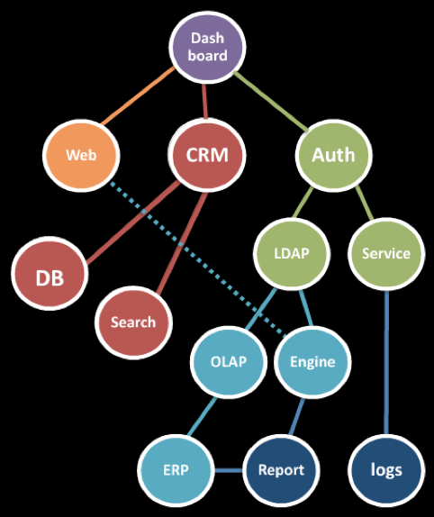
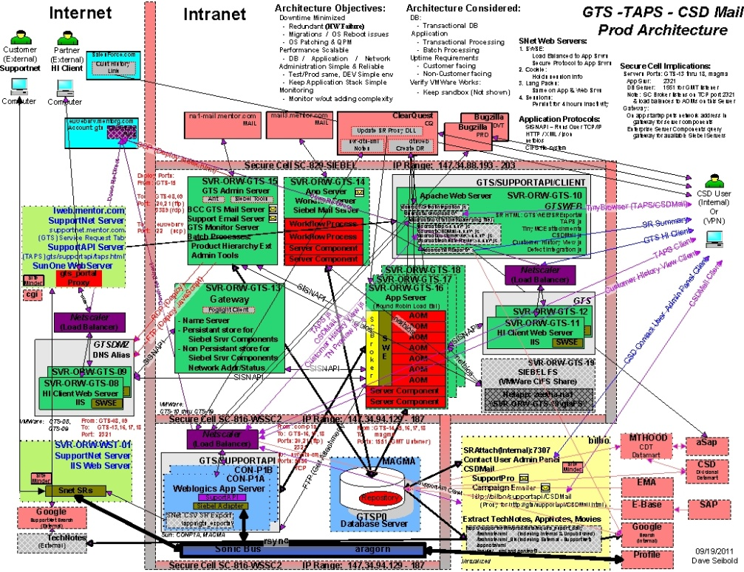
Cloud Candidate Selection Tool in Use
Step 1. Architectural Decomposition
(start with a diagram)
A process of resolving a functional relationship into its constituent parts in such a way that the original function can be reconstructed
Notes:
This is the wikipedia definition of decomposition.
Start with a diagram.
Start with a ‘good’ architectural description that identifies key components and dependencies, reasonable granularity (≤15 / maps well to functions and products)

Slide 46
Cloud Candidate Selection Tool in Use
Step 2. Qualitative Scoring
Score Each Component Across 20+ Criteria
High Availability Approach
Availability Requirement
Latency Requirements
Integrations
Government Regulations
Statefulness
Scalability Limitations
Release Process
QoS
Licensing Model
Time to Deploy
License Mobility
User Security
User Locality
Parallelism
Development Model
Development Environment
Failure Consequence
Demand Predictability
Device Dependence
Data Locality
ROI Runway
Public Availability
Notes:
Relative to MM, CCST is more malleable – it’s expected that modifications may be necessary. These may not be the right criteria. Like MM, it’s easy to ignore individual criteria, but you may also want to add new ones …

Slide 47
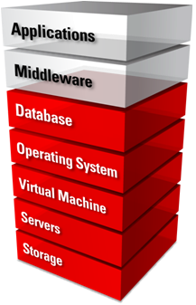
Need kit?
Notes:
So … you now know how to do DBaaS … If you’re deploying a private DBaaS/Cloud you’ll want kit.

Slide 48
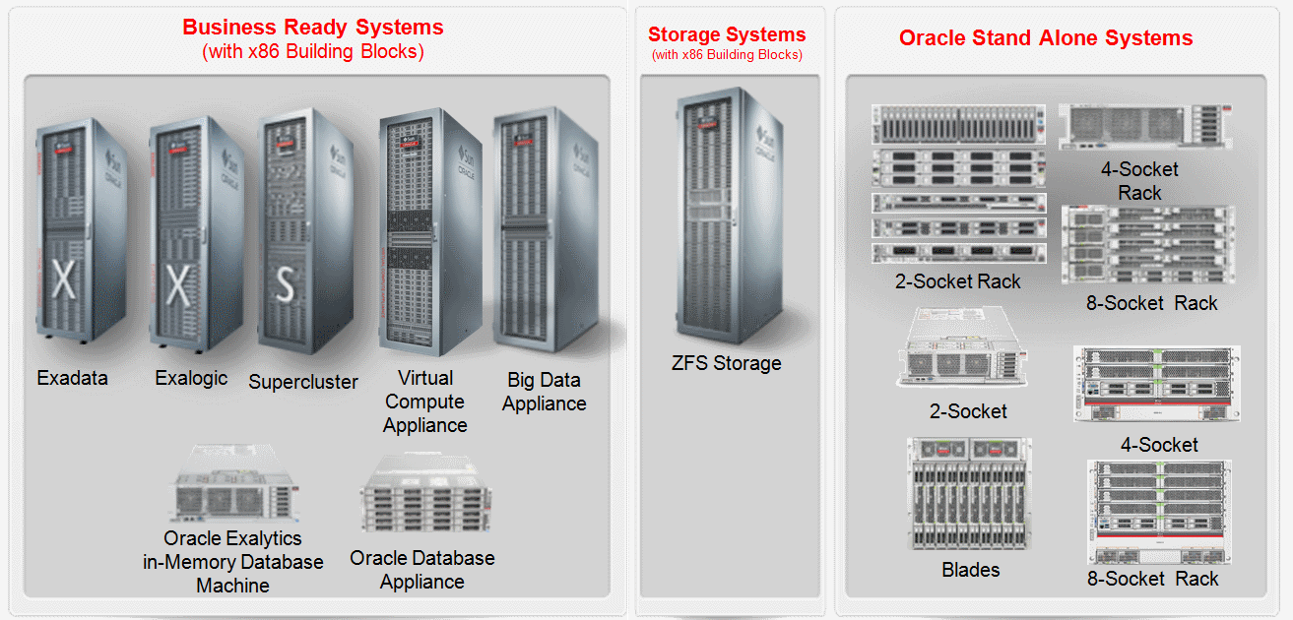
Oracle Private DBaaS Platforms
Notes:
Shameless plug of systems that are PODs, are extendable, extensible, resilient,

Slide 49






















Oracle Public Cloud Services
Global Human
Resources
Talent Management
Service
Marketing
Sales
Enterprise Resource
Planning
Enterprise Performance
Management
Applications
Social Marketing
Social Engagement & Monitoring
Social Enterprise Network
Social Data & Insight
Content, Analytics, User Engagement as-a-Service
Documents
Social
Networking
Business
Intelligence
Big Data
Big Data
Discovery
Internet
of Things
Integration
as-a-Service
Process
Integration
SOA
Data
Integration
GoldenGate
Security & Identity
as-a-Service
Management as-a-Service
Identity
Development & Deployment
as-a-Service
Database
Java
Developer
Messaging
Mobile
Java SE
Node.js
Compute, Storage & Network as-a-Service
Database
Backup
Compute
Storage
Notes:
If you’re looking for Public Cloud.
This is clearly beyond DBaaS.
You could pick this alone but best practice “builds for the cloud in the cloud” and unless your application is an APEX app – you’re going to want more services.
Consider evolution – it will happen
Which road (public or private) will you take? Standardisation applies here too.
Hybrid: It’s not always either or!
I thought about discussing hybrid cloud – a mix of public and private but that’s a topic for another day.

Slide 50
Context – Oracle Capabilities
Notes:
One almost last slide but if you look carefully you will see Oracle products layered on top of that NIST architecture.

Slide 51

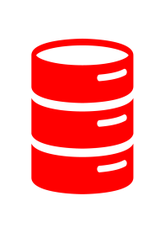
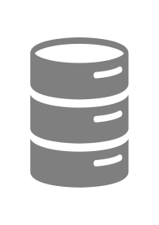




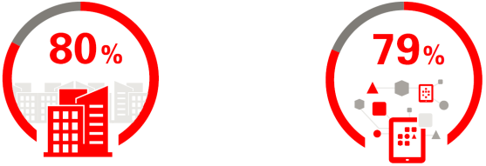

Five Best Practices To Maximise Value
Standardise and Consolidate
Choose Comprehensive & Integrated
50%
Organisations reporting operational savings of up to 50%
75% of Organisations want a platform with well integrated capabilities
Ensure Traditional Data Centre Capabilities
Service-level guarantees are rated as important or very important by 82% of organisations
Consider Unified, Standards-based platforms for portability
Move Development and Test
82%
Dev and Test will become most popular use case rising from 39% to 52%
52%
80% Organisations prioritise a unified, standards-based platform
79% Rate ease of integration of data and apps as high priority
39%
ComputerWorld Cloud Computing Survey, sponsored by Oracle, September 2014. Survey Title: Customers Speak: Cloud Needs Guarantees; http://www.oracle.com/goto/computerworld
Notes:
My last –
You could boil all of my previous slides down to this one.
This is the whole discussion on a slide. -- Why and how.

Slide 52
Lessons Learned
Don’t underestimate the effort
Simplify Installation, Patching and Management
Build for Easy Diagnosability
Customers Expect Agility
Automated Tests are a Must
Secure Everything
Develop in the Same Environment as Customers
Notes:
1) It’s not “just provisioning” even if you have a stable on-premise product. Think about end-to-end lifecycle management.
2) Don’t expect end-users to bother about patching, backup, recovery i.e. think Gmail, not Outlook.
3) Don’t depend on Support Admin being able to solve problems in the way on-premise works.
4) Frequent releases are the norm in the cloud
5) Agility cannot come at the price of shipping unstable code. A single issue can bring down all customer PODs
6A) Firewall is only the first line of defense
6B) Don’t forget network level security, virus protection and other intrusions.
6C) Audit and track everything e.g. logins, logouts, sensitive operations such as deletes
7A) “It works on my machine” is not a valid argument!
7B) Develop in the same type of topology a customer would use e.g. OHS, OAM, SSO, WLS Cluster etc.
It also forces you to think about what it costs us for customers to run our software.
E.g. do you really need a database schema, or would files on a storage service suffice?
If we can’t afford unlimited disk space for log files or daily DBA intervention to purge tables, so would our customers.

Slide 53
Thank you

Slide 54
Notes:
This is a Safe Harbor Back slide, one of two Safe Harbor Statement slides included in this template.
One of the Safe Harbor slides must be used if your presentation covers material affected by Oracle’s Revenue Recognition Policy
To learn more about this policy, e-mail: Revrec-americasiebc_us@oracle.com
For internal communication, Safe Harbor Statements are not required. However, there is an applicable disclaimer (Exhibit E) that should be used, found in the Oracle Revenue Recognition Policy for Future Product Communications. Copy and paste this link into a web browser, to find out more information.
http://my.oracle.com/site/fin/gfo/GlobalProcesses/cnt452504.pdf
For all external communications such as press release, roadmaps, PowerPoint presentations, Safe Harbor Statements are required. You can refer to the link mentioned above to find out additional information/disclaimers required depending on your audience.

