Slide 1

A Quantum of Computing
…using the Incomprehensible to solve the Intractable …
Dave McMahon
dave@nxtgenug.net
@mcmahond
http://davemcmahon81.wordpress.com

Slide 2

Your Speaker
15 years in Software Industry
9 years Software Systems Architect at Ridgian
Co-Founder The Next Generation User Group
Spoken at User Groups, DDD’s, TechEd
First Class Honours Degree in Theoretical Physics From York University 1983

Slide 3
The Aim
To show you how Quantum Theory and Quantum Effects are being used to bring about future generations of computers
Notes:
Short

Slide 4

The Agenda
Limits of the ‘Von Neumann’ Machine
What can Quantum Computing Offer?
The QuBit
A Basic Quantum Algorithm
A Quantum Search Algorithm
Quantum Computers Today
Notes:
Full

Slide 5
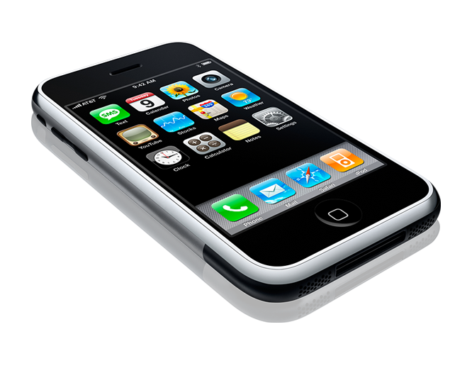

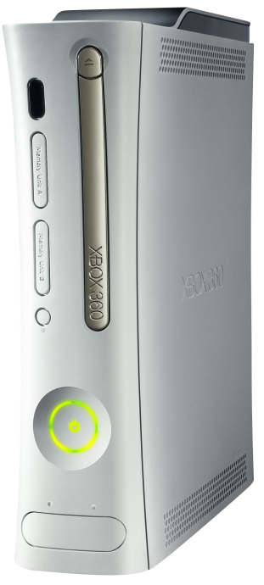

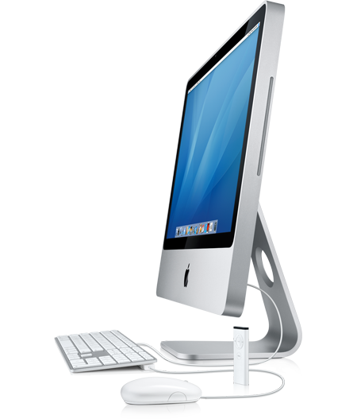
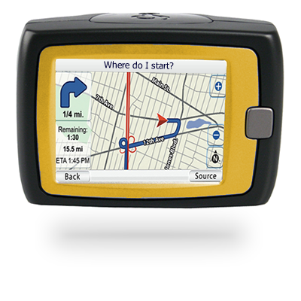
‘Von Neumann’ Machine

Slide 6
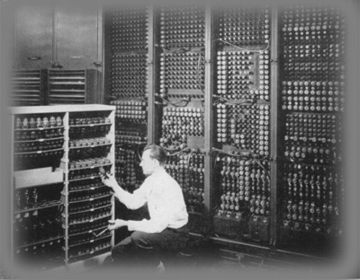
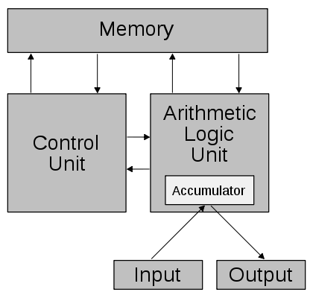
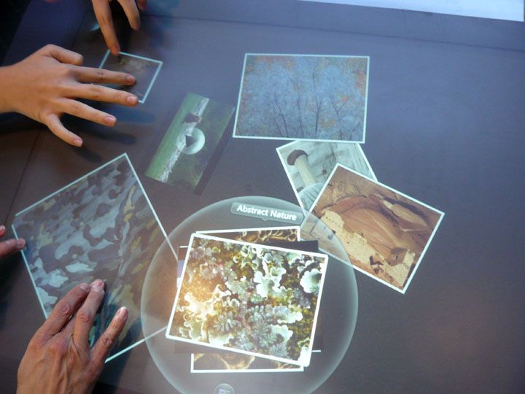
‘Von Neumann’ Machine

Slide 7
Limits of the Von Neumann Machine
Quantum Limitations
Relativistic Limitations
Classical Limitations

Slide 8
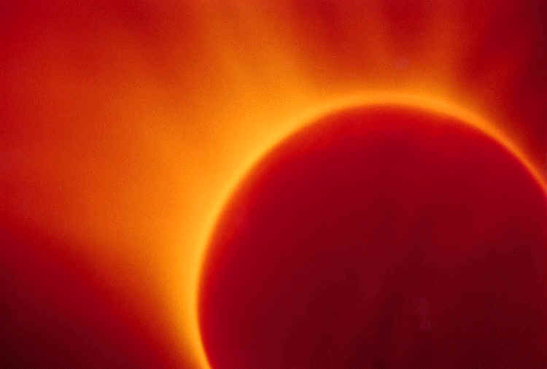
Classical Limitations
Heat

Slide 9
Classical Limitations
Heat is the main reason that:
  Clock speeds are not increasing
  Multi-core architectures are becoming the norm
Heat will (probably) :
  Signal the end of the CMOS chip
  Result in other technologies replacing it
However, let us assume that we do solve the heat problem ...

Slide 10

Quantum Limitations
Measurement and Manufacture

Slide 11

Quantum Limitations
Quantum Limitations will:
  Limit the accuracy to which chips can be made with current etching technology
  Limit the size to which individual transistor gates can be miniaturised
Quantum Limitations are a natural limitation to evermore miniaturisation
Let’s assume however that we overcome these issues ...

Slide 12
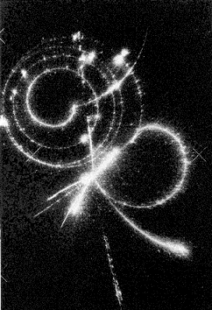
Relativistic Limitations
Timing and Energy

Slide 13
Relativistic Limitations
Consider a 3 GHz processor (off today’s shelf)
  In 1 cycle a signal can propagate at most c/(3 GHz) = ~ 10cm
  For a 1-cycle round-trip to cache memory and back the cache location can be at most ~5 cm away.
  Electrical signals travel at ~0.5 c in typical materials therefore in practice, a 1-cycle memory can be at most ~2.5 cm away
As clock speeds increase architectures must be increasingly local.

Slide 14
Relativistic Limitations
Computer systems are powered at 10V which equates to 10 eV.
Corresponds to a max clock speed of 9.7 PHz
  ~ 5 million times faster than today’s CPUs
  ~ 100,000 times faster than today’s superconducting logics

Slide 15
Where do we go from here?
perhaps
Quantum Computing

Slide 16
What Can Quantum Computing Offer?
Reversible Computation
Speed of Computation
Different Modes of Computation

Slide 17
How can you use Quantum Effects to do Computation?
So …
… consider the classic ‘Double Slit’ experiment …

Slide 18
The Double Slit Experiment – Part 1
Beam of Light
Barrier with a Single Slit
Light waves ‘fan out’ like water waves
Detector Screen
Shows ‘Blurred’ pattern

Slide 19
The Double Slit Experiment – Part 2
Beam of Light
Barrier with a Double slit
Light waves ‘fan out’ like water waves
Detector Screen
Shows ‘Interference’ Pattern

Slide 20
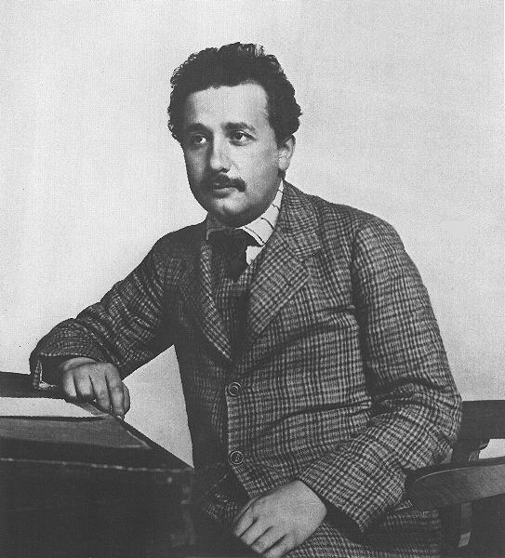
The Double Slit Experiment – Part 2
A Beam of Light
Barrier with a double slit
Light waves ‘fan out’ like water waves
... but Light Beams are NOT made of waves . They are made of particles called Photons ...
A Detector Screen
Now shows an ‘Interference’ pattern

Slide 21
The Double Slit Experiment – Part 3
Beam of Light
Barrier with a Double slit
Photons ‘Interfere’?
Detector Screen
Shows
‘Interference’ Pattern

Slide 22
The Double Slit Experiment – Part 4
Beam of Light
Barrier with a Double slit
Photons ‘Interfere’?
Detector Screen
Still Shows
‘Interference’ Pattern

Slide 23
The Double Slit Experiment – Part 5
Beam of Light
Barrier with a double slit
Detect
Photon?
Detector Screen
No
‘Interference’ Pattern

Slide 24
The Double Slit Experiment
Questions:
  How does the Photon know where to end up?
  If there is interference, what does the Photon interfere with?
  Why does trying to detect what is happening affect the outcome?
There are many different Quantum Theory Interpretations which scientists 100 years after the discovery of quantum nature of light are still arguing about .

Slide 25
Quantum Theory Interpretation
Quantum Theory Interpretations try to explain what is happening
  Copenhagen Interpretation
  Instrumentalist - “Shut up and calculate!”
  Others …
  The Many Universes Interpretation (Multiverse)
They don’t have to be true. They only have to be consistent.

Slide 26
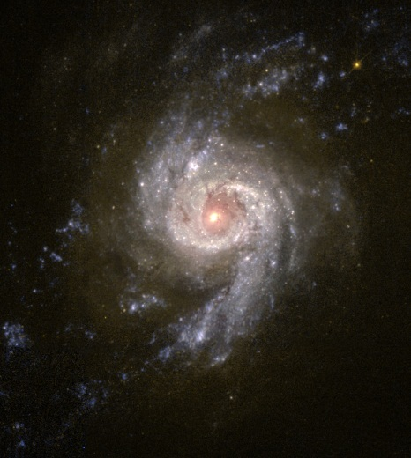

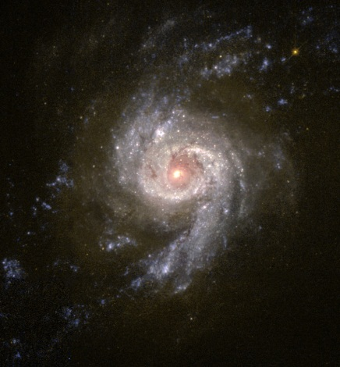








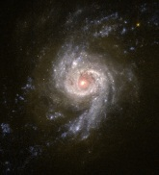






The ‘Multiverse’
We are aware of only a part of reality
Every object in a universe has a counterpart in another universe

Slide 27

The ‘Multiverse’
Counterparts can behave differently from each other
Counterparts can affect each other at the Quantum level
Result of effects is Quantum Interference

Slide 28
The ‘Multiverse’
Across the multiverse, the photon goes through both slits at the same time a phenomenon known as Superposition
The Photons experience Quantum Interference with each other between universes
The final resulting pattern is a interference pattern across the Multiverse.

Slide 29
The QuBit
A Multiversal Object

Slide 30
The QuBit
The Quantum World
Superposition
QuBit
Quantum Interference

Slide 31

The QuBit
Physicists measure Expectation Values of Quantum Systems or Observables
Expectation Values of Quantum Observables are:
  The average outcome of a measurement repeated many times or ...
  The average outcome of a measurement performed on many copies of a system over a region of the Multiverse.
If a Quantum System has Observables which are all defined in terms of Boolean Values that system can be termed a QuBit.

Slide 32
The QuBit
A Bit : A classical system which can take one of two values – one or zero
A Boolean Observable: A Quantum Observable whose spectrum contains two values and which can be either or both values simultaneously.
  Sharp (Same Value in all Universes)
  Non-Sharp (Superposition)
A QuBit : A physical system, each of whose non-trivial observables is Boolean

Slide 33
A Single QuBit System

Slide 34
A Single QuBit System
An observable ‘Z’ is deemed to be -1 when going to the North Direction and 1 when going in the East Direction. <Z(t)> is the Expectation (Average) Value being measured.
North
Time | <Z(t)>
0 | 1
East
Mirror
Beam Splitter
Beam Splitter
Mirror

Slide 35
A Single QuBit System
At Time 1 the Observable ‘Z’ is in SuperPosition with the photon going in both the North Direction and the East Direction in Different Universes. The Expectation Value of Z(t) is therefore 0.
North
Time | <Z(t)>
0 | 1
1 | 0
East
Mirror
Beam Splitter
Beam Splitter
Mirror

Slide 36
A Single QuBit System
At Time 2 the Observable ‘Z’ is in SuperPosition with the photon going in both the East Direction and the North Direction in Different Universes. The Expectation Value of Z(t) is therefore still 0.
North
Time | <Z(t)>
0 | 1
1 | 0
2 | 0
East
Mirror
Beam Splitter
Beam Splitter
Mirror

Slide 37
A Single QuBit System
Theoretical predictions backed up by experimental observations show that the East detector always picks up the Photon and the North Detector never does. So the Expectation value Z(t) is now 1.
North
Time | <Z(t)>
0 | 1
1 | 0
2 | 0
3 | 1
East
Mirror
Beam Splitter
Beam Splitter
Mirror

Slide 38
A Single QuBit System
Any attempt to determine an intermediate state results in a final expectation value for Z(t) of 0. In this case photons appear at both detectors.
North
Time | <Z(t)>
0 | 1
1 | 0
2 | 0
3 | 0
East
Mirror
Beam Splitter
Beam Splitter
Mirror

Slide 39
A Real QuBit
This is how a system can use a single QuBit to measure a specific value of -1 or 1.
North
Time | <Z(t)>
0 | 1
1 | 0
2 | 0
3 | 1
East
Mirror
Beam Splitter
Beam Splitter
Mirror

Slide 40
A Real QuBit
NOT Gate
What’s This?
Mirror
Beam Splitter
B
N
B
B
N
B
Input
Output
Input
Output
Beam Splitter
Mirror
New Mode of Computation
t=0
t=1
t=2
t=3
Operation is Unit Operator

Slide 41

Quantum Computations are Reversible
WARNING!
Severe Scientific Reasoning Break ...

Slide 42

Quantum Computations are Reversible
Gates represented by unitary matrices
  $\left({0 1 \atop 1 0}\right) or \left({0 −i \atop i 0}\right) or\left({1 0 \atop 0 −1}\right) or \left({1 0 \atop 0 1}\right)$
All unitary matrices have inverse matrices that are also unitary
… so all quantum gates are reversible …
… gates represent computations …
… so all quantum computations are reversible.

Slide 43
Quantum Computations are Reversible
END OF
Severe Scientific Reasoning Break ...

Slide 44
Quantum Computations are Reversible
x
f(x)
x
y
yf(x)
Must have same number of outputs as inputs
Must preserve the original input
Copies the result to the ‘control’ QuBit

Slide 45
A Basic Quantum Algorithm

Slide 46
A Basic Quantum Algorithm
A Program is a way of preparing a computer to carry out a Computation
A Computation is a problem to which an Algorithm is a solution
An Algorithm is a Hardware-independent specification of a Computation

Slide 47
A Basic Quantum Algorithm
Question: Can we find out what the Boolean function f(x) is without looking inside the Black Box?
x
f
x
y
yf(x)
f(x) = 1 OR f(x) = -1
Unit Operator
NOT Operator
Constant 1
Constant -1

Slide 48
A Basic Quantum Algorithm
x=1
f
x=1
x=-1
f
x=-1
y=1
f(1)
y=1
f(-1)
Must Run System Twice
True for both classical and quantum versions

Slide 49
A Basic Quantum Algorithm
x=1
f
x=1
x=-1
f
x=-1
y=1
f(1)
y=1
f(-1)
What about does f(1) = f(-1)?
Same as f(1)f(-1)
Classically we must still run the system twice.

Slide 50
A Basic Quantum Algorithm
|1>
|1>|-1>
f
|1>|-1>
|1>
Q1
H
H
|1>
|-1>
|-1>|1>
f(|1>|-1>) = f(|1>)f(|-1>)
Q2
NOT
H
We prepare our two inputs using a NOT Gate
We put our QuBit into a State of Superposition using Hadamard Gate (Superposition state represented by |1>|-1>)
Run the Calculation f
f(|1>)(f|-1>) appears in ONE run of the system
Demonstrates Quantum Parallelism

Slide 51
A Quantum Search Algorithm

Slide 52
A Quantum Search Algorithm
Exhaustive Search Algorithm
Example in C# Programming Language
  public Boolean Is151InAList(Ilist<Int32> aList)
  {
    for (Int32 i=0 ; i < aList.Count() ; i++)
    {
      if (aList[i] == 151) {return true;}
    }
    return false;
  }
Classically this would take on average half the number of items in the list i.e N/2. It could take N-1 times.

Slide 53
A Quantum Search Algorithm
F(x) is -1 when X is the searched for value
F(X) is 1 when X is not the searched for value.
X is in the range 0 -> N where N = 2^{L}
F
L QuBits
x
x
1 QuBit
y
yF(x)

Slide 54
A Quantum Search Algorithm
H puts L QuBits in Superposition
Place four Quantum Gates M H B H in succession
MHBH is the Grover Operator
G
H
M
H
B
H
L QuBits
x
Aux QuBit
y

Slide 55
A Quantum Search Algorithm
Expectation Value
Superposition State (H)
The ‘Grover Operator’
Expectation Value
Mark Target (M)
T(arget)
Grover
Diffusion Operator (HBH)
(Invert about Average)
T
Expectation Value

Slide 56
A Quantum Search Algorithm
Consider the combined QuBit states as a vector
The Grover Operator rotates vector towards target
Target State
Initial State

Slide 57
A Quantum Search Algorithm
Grover Search Algorithm = Hadamard Gate + Repeated Grover Operators.
Maths shows ~ √N Grover Operations needed
H
G
G
G
L QuBits
x
x
Aux QuBit
y
yF(x)

Slide 58

A Quantum Search Algorithm
At 100 million Grover operations per second
Searching 10³⁰ items
~4 months

Slide 59
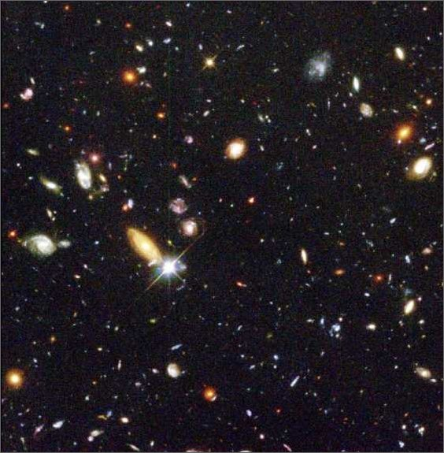
A Quantum Search Algorithm
At 100 million Classical Operations per second
Searching 10³⁰ items
~Age of Universe

Slide 60

A Quantum Search Algorithm
Using a Quantum Computer you would be running 10³⁰ operations in parallel.
That’s more operations than if you took all the Silicon on Earth and made it into transistors and ran them all in parallel!
Notes:
“Using a quantum computer you would be running 10³⁰ operations in parallel. That’s more operations than if you took all the Silicon on Earth and made it into transistors and ran them all in parallel!”

Slide 61
Finally …
Quantum Computers Today
… back to reality …

Slide 62
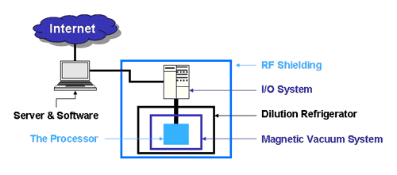
Quantum Computers Today
Quantum Encryption Devices
  http://www.magiqtech.com/
University of Innsbruck
  14 Qubit Calculation (1 Apr 2011)
D-Wave Machine
  http://www.dwavesys.com
  http://scottaaronson.com/blog
  128 Qubit calculation?

Slide 63
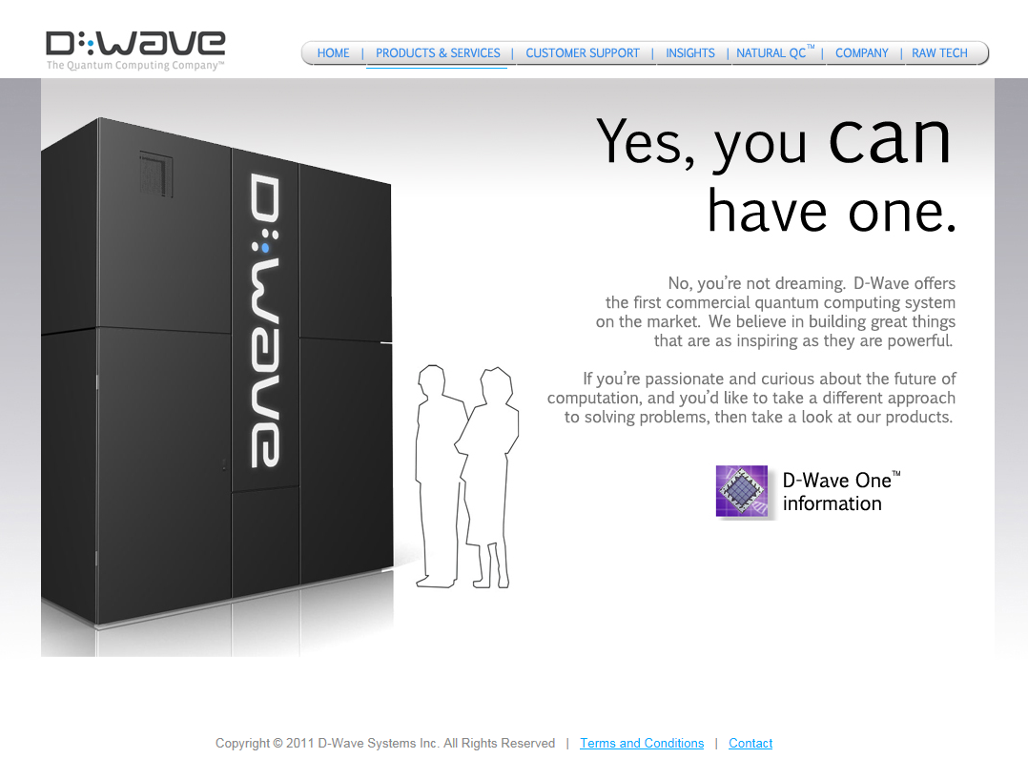
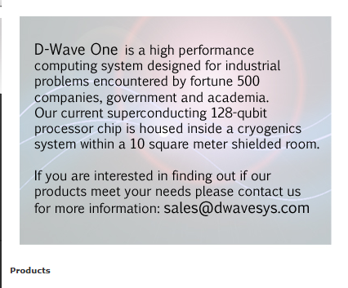
Quantum Computers Today

Slide 64
Summary
We will reach a limit on current CMOS technology soon
Quantum Computing makes use of the ‘Quantum Multiverse’
Trying to observe what happens destroys Quantum Interference
Some known Quantum Algorithms will make certain intractable problems do-able
A viable Universal Quantum Computer is yet to be built.

Slide 65
A Quantum of Computing
Qs & As
Thank You
Dave McMahon
dave@nxtgenug.net
@mcmahond
http://davemcmahon81.wordpress.com

