Slide 1
The Principles of OPERATIONS
Scott Maxwell

Slide 2
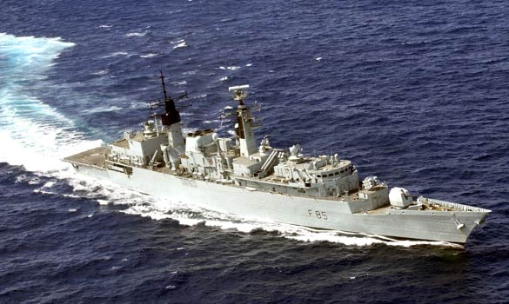
Notes:
In 2005, serving on board HMS cumberland, Type 42 Destroyer.
Talk about lead up to crash on deck.

Slide 3
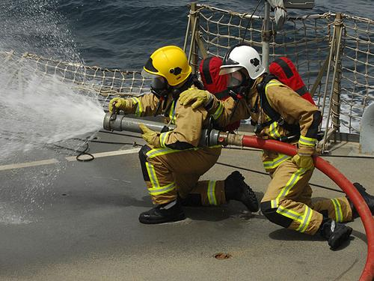
Notes:
Leading small four man team in crash on deck.

Slide 4
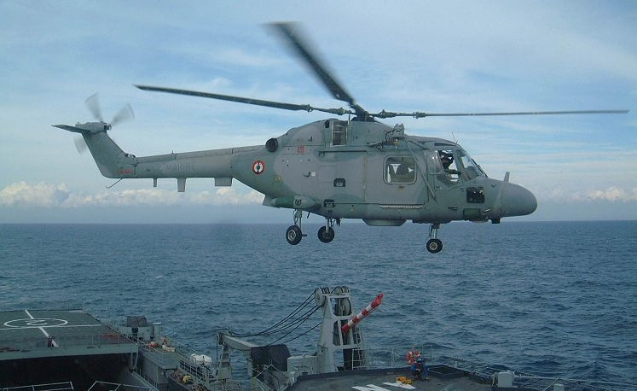
Notes:
Leading small four man team in crash on deck.

Slide 6
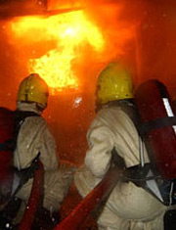
Notes:
This is what I was expecting to see.

Slide 7
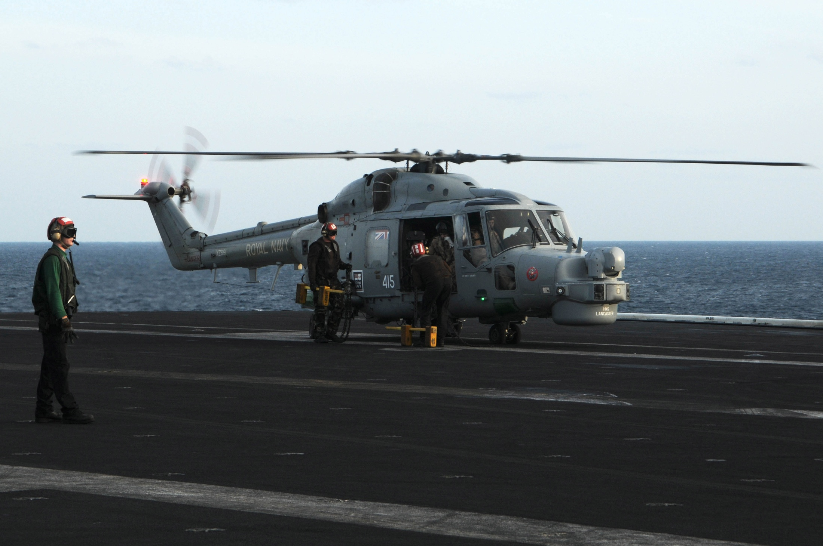

Slide 8
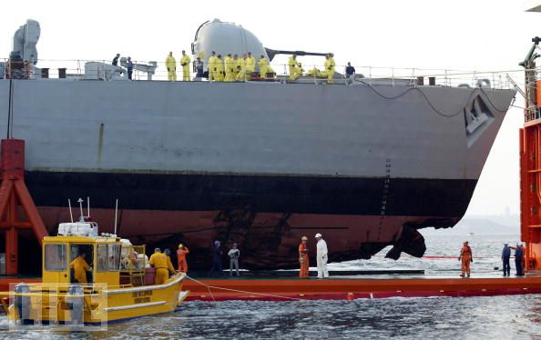

Slide 9
Introduction
Principles of Operations in War
How they can be applied to IS Operations
Conclusions

Slide 10
Who am i?
Lt RN, Engineering IS Officer
Served on:
HMS Cumberland (Small Ship)
HMS Albion (Big Ship)
HMS Illustrious (Very Big Ship)
Service Delivery Manager HMS RALEIGH
UK TRIDENT Targeting Officer ‘07-’10
Re-civilianised Mar 2010

Slide 11
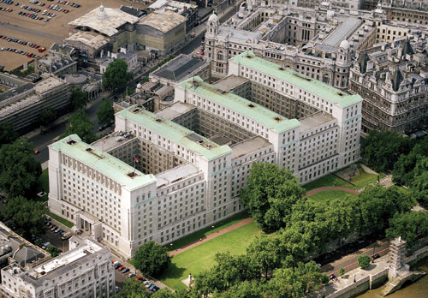
Nuclear operations and targeting centre
(See www.secret-bases.co.uk)

Slide 12
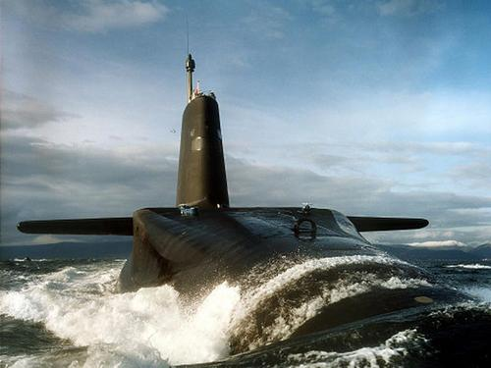
Nuclear operations and targeting centre

Slide 13
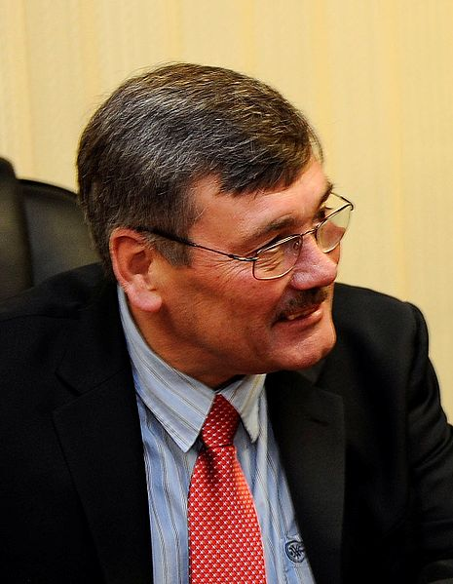
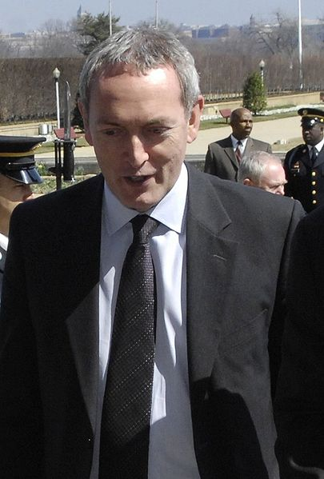
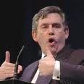
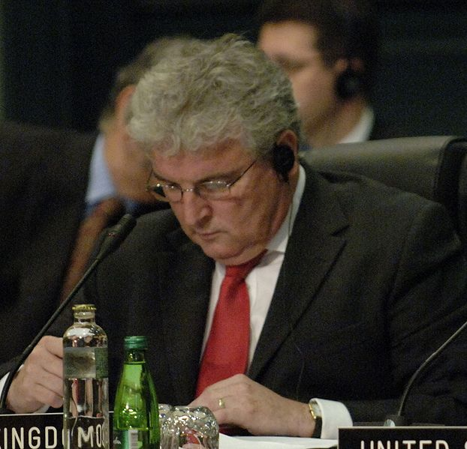
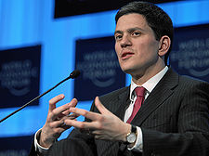
Nuclear operations and targeting centre

Slide 14
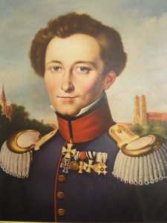
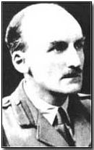
Principles of Operations (i.e. War)

Slide 15
Principles of Operations (i.e. War)

Slide 16
Principles of operations
Selection & Maintenance of the Aim
Maintenance of Morale
Offensive Action
Security
Surprise
Concentration of Force
Economy of Effort
Flexibility
Sustainability
Cooperation

Slide 17
Selection & maintenance of the aim
Master Principle
Single unambiguous aim
Cdr’s intent communicated to whole CoC
Plans constantly checked against aim

Slide 18
(Insert video mandraulically)

Slide 20
Maintenance of morale
Created by inspired leadership
Shared sense of purpose & values
Perceptions of worth and group cohesion
Needed throughout whole CoC

Slide 21
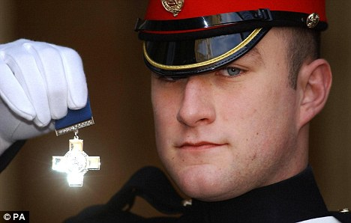

Slide 22
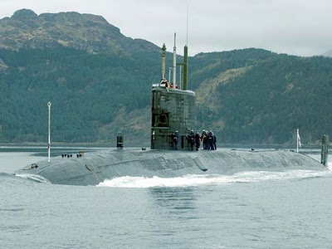

Slide 23
Offensive action
Freedom to compel the situation
Seek advantage
Sustain momentum & initiative
Exploit opportunities

Slide 24
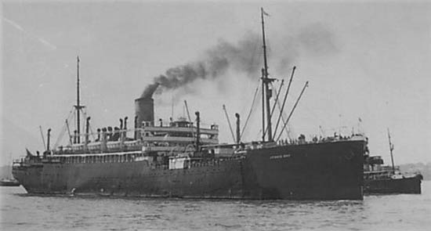
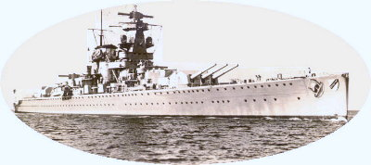

Slide 25
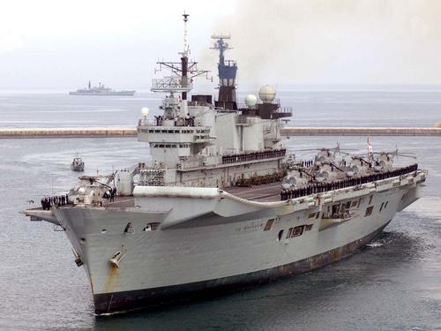

Slide 26
security
Provision of free ops environment
Optimisation of Risk
Protect high value assets & activities
NOT guarding against every event

Slide 27
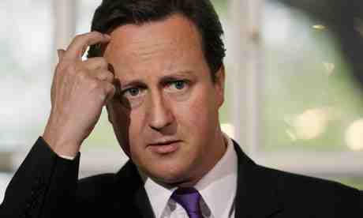
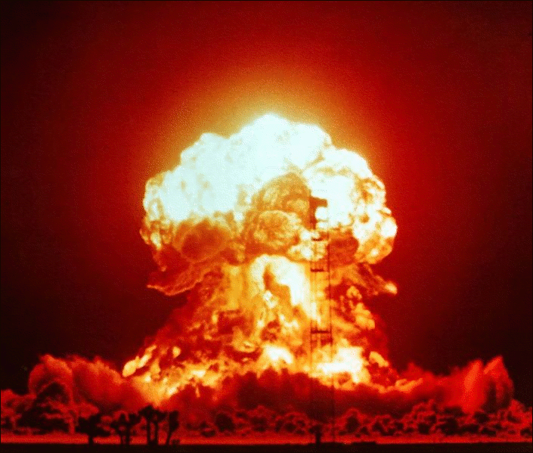
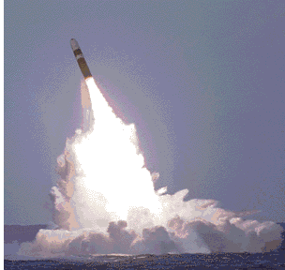

Slide 28
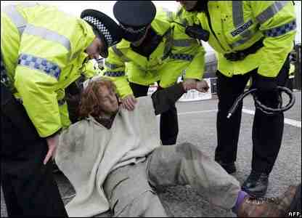
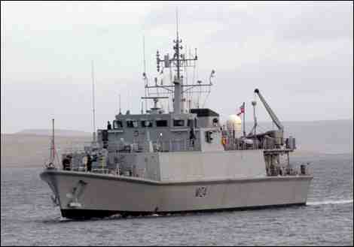
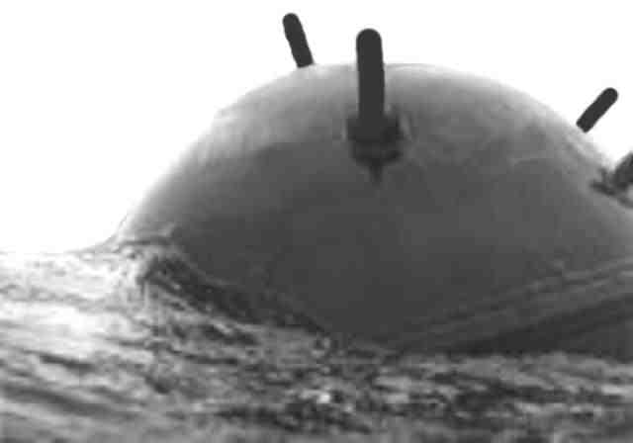
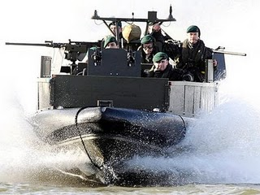

Slide 29
surprise
Deliberate introduction of unexpected
Secrecy, concealment and deception
Originality, audacity and temp
Undermines opponents coherence
Imposed by:
Manoeuvre
Novel technology
Unfamiliar activities

Slide 30
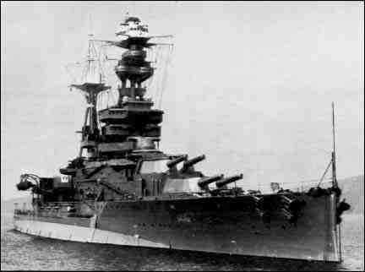
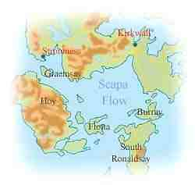

Slide 31
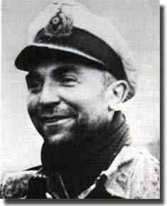
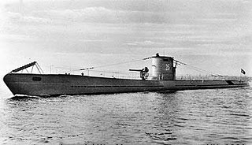

Slide 32
Concentration of force
Decisive application of superior power
Synchronised and robust
Aimed to achieve effects
Can be achieved through:
Superior Command & Control
Deception
Superior Technology
Operational Control

Slide 33
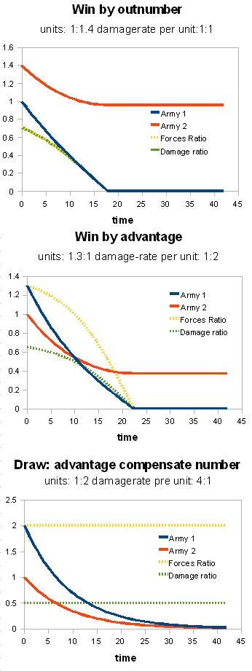
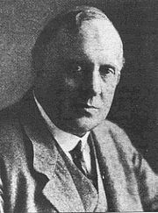
Frederick Lanchester
(Power₁ / Power₂)²

Slide 34
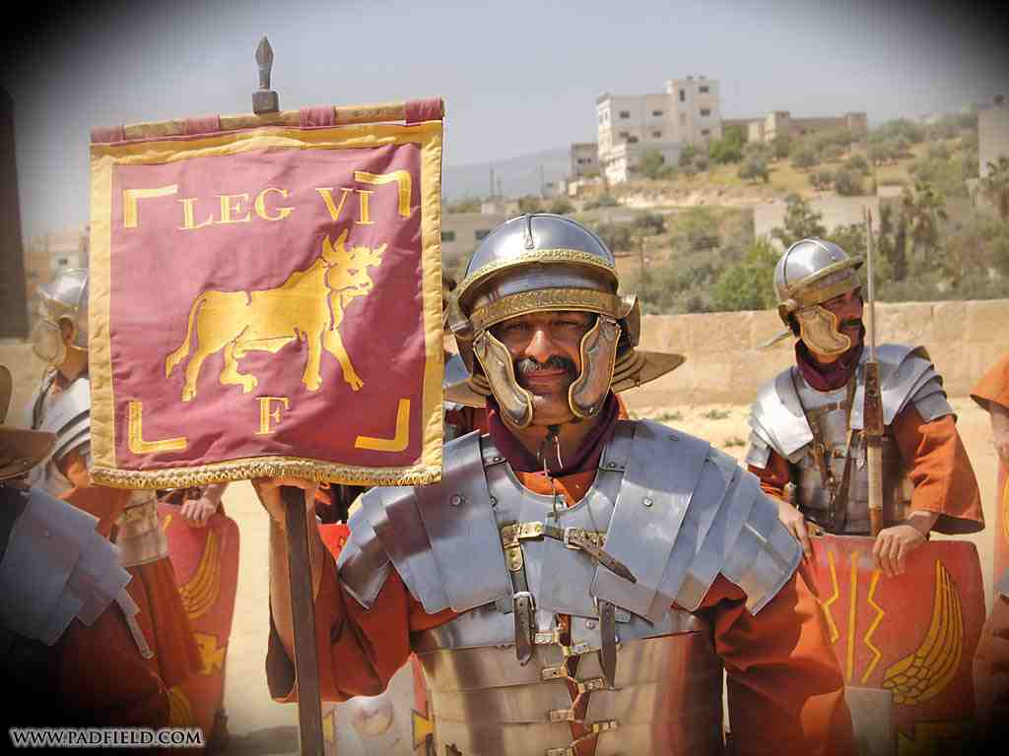
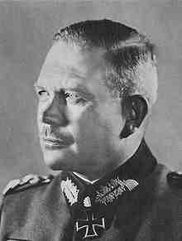

Slide 35
economy of effort
Judicious exploitation of resources
Aimed at achieving objectives
Requires relative prioritisation
Improves sustainability of demands
Relies on:
Right Tools
Right Plan
Right Time
Right Effort

Slide 36
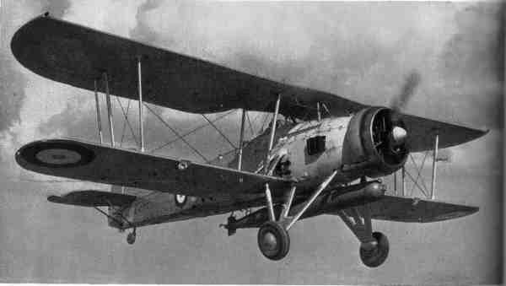
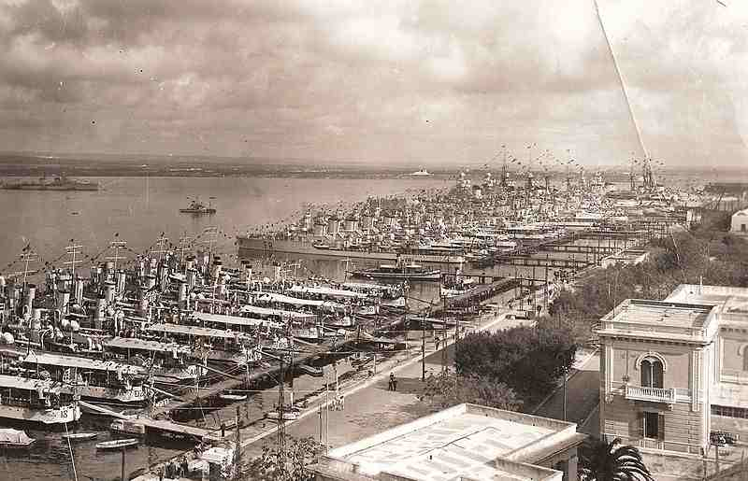

Slide 37
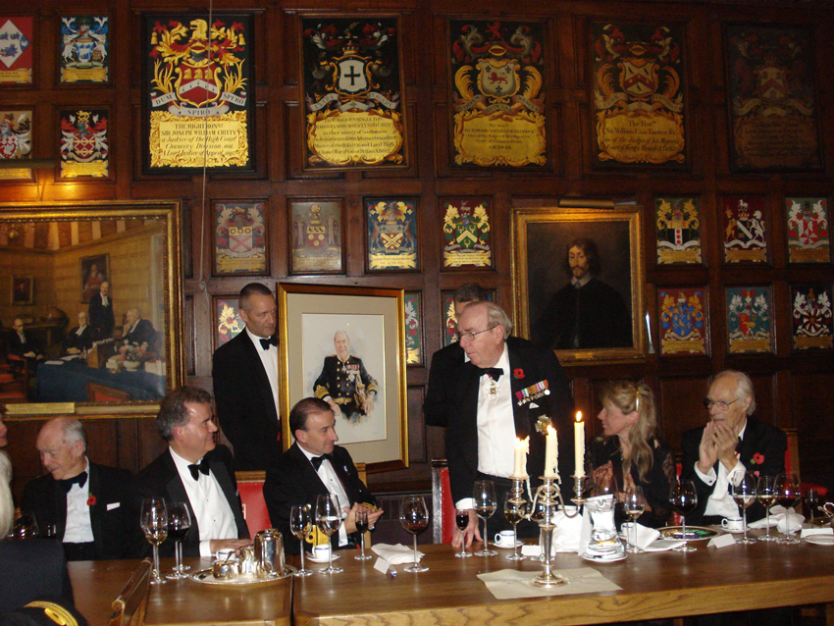

Slide 38
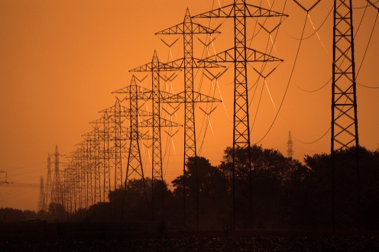
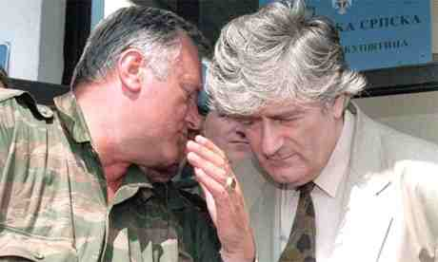
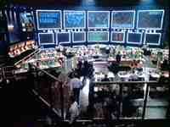
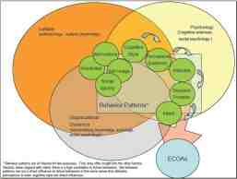

Slide 39
flexibility
Ability to meet changing circumstances
Comprises:
Agility – Physical
Responsiveness – Structural
Resilience – Remaining effective
Acuity – Sharpness of thought

Slide 40
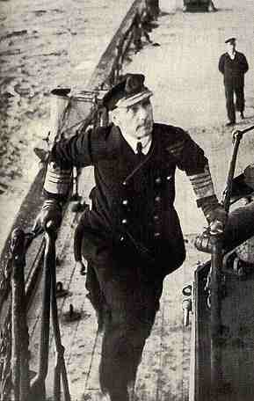
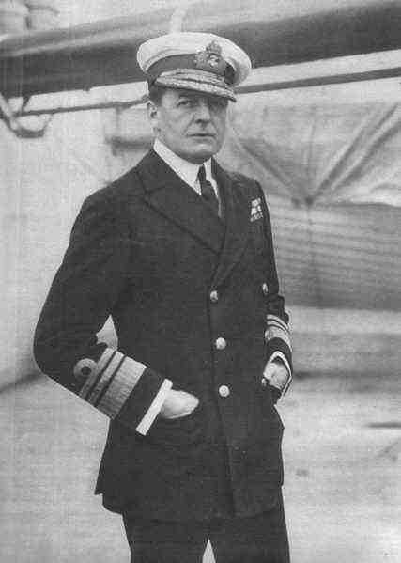

Slide 41
sustainability
Generate and sustain freedom of action
Comprises:
Personnel
Equipment & Materiel
Supplies & Support
Deciding factor in feasibility of ops

Slide 43
cooperation
Teamwork and burden sharing
Understand/compensate for limitations
Harmonised goals
Relies on:
Mutual Trust & Goodwill
Common Aim
Clear division of responsibilities

Slide 44
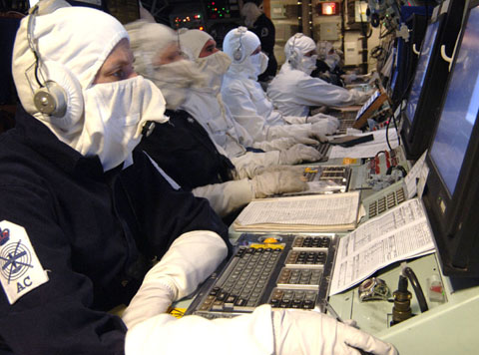

Slide 45
Principles in is operations
Selection & Maintenance of the Aim
Maintenance of Morale
Offensive Action
Security
Surprise
Concentration of Force
Economy of Effort
Flexibility
Sustainability
Cooperation

Slide 46
Some examples:

Slide 47
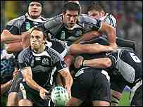
Selection & Maintenance of the Aim

Slide 48
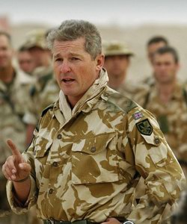
Maintenance of Morale

Slide 49
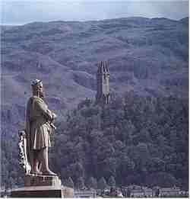
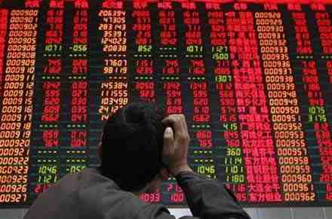
Offensive Action

Slide 50
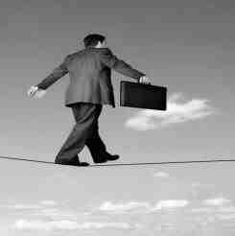
Security

Slide 51
Surprise

Slide 52
Concentration of Force

Slide 53
Economy of Effort

Slide 54
Flexibility

Slide 55
Sustainability

Slide 56
Cooperation

Slide 57
Any more?

Slide 58
Questions?

