Slide 1
Their mind in your hands: User centric digital mental health
Mel McKendrick, PhD, Mres, MA, CPsychol
Assistant Professor in Psychology
Heriot-Watt University

Slide 2
Agenda
Background
Assessment - Digital biomarkers
Digital interventions
Problems
Current work and vision for future

Slide 3
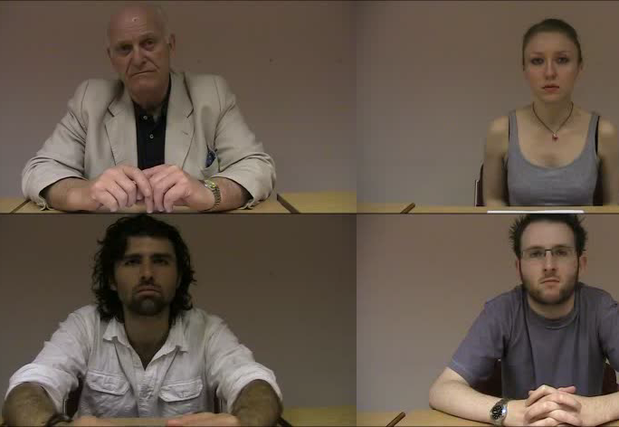
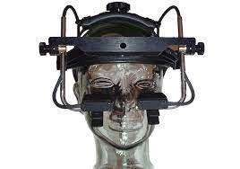
The role of self-relevance, attention and online interpretation of social cues in social anxiety

Slide 4
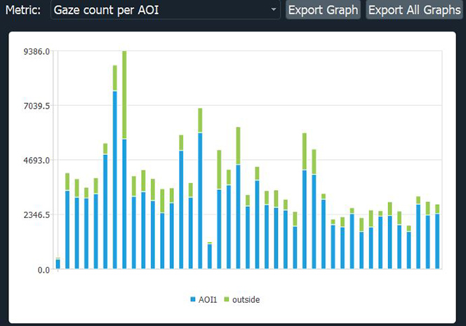
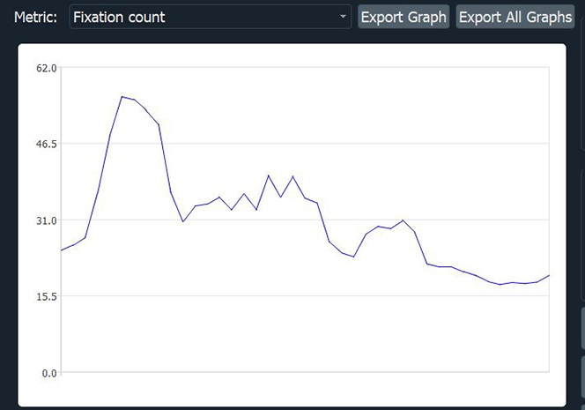

Slide 5
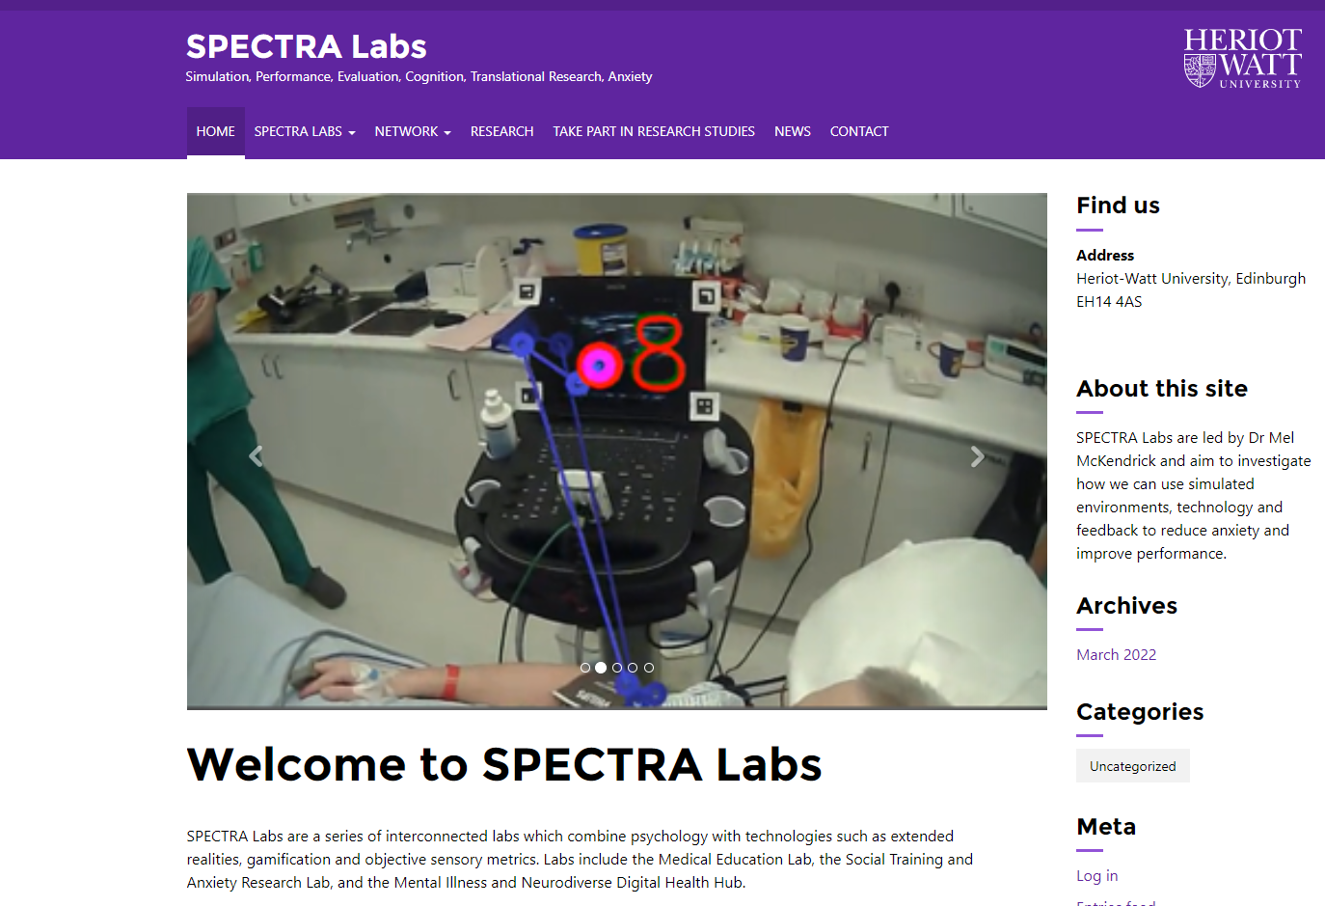
https://spectra.site.hw.ac.uk/

Slide 6
https://spectra.site.hw.ac.uk/mel/

Slide 7
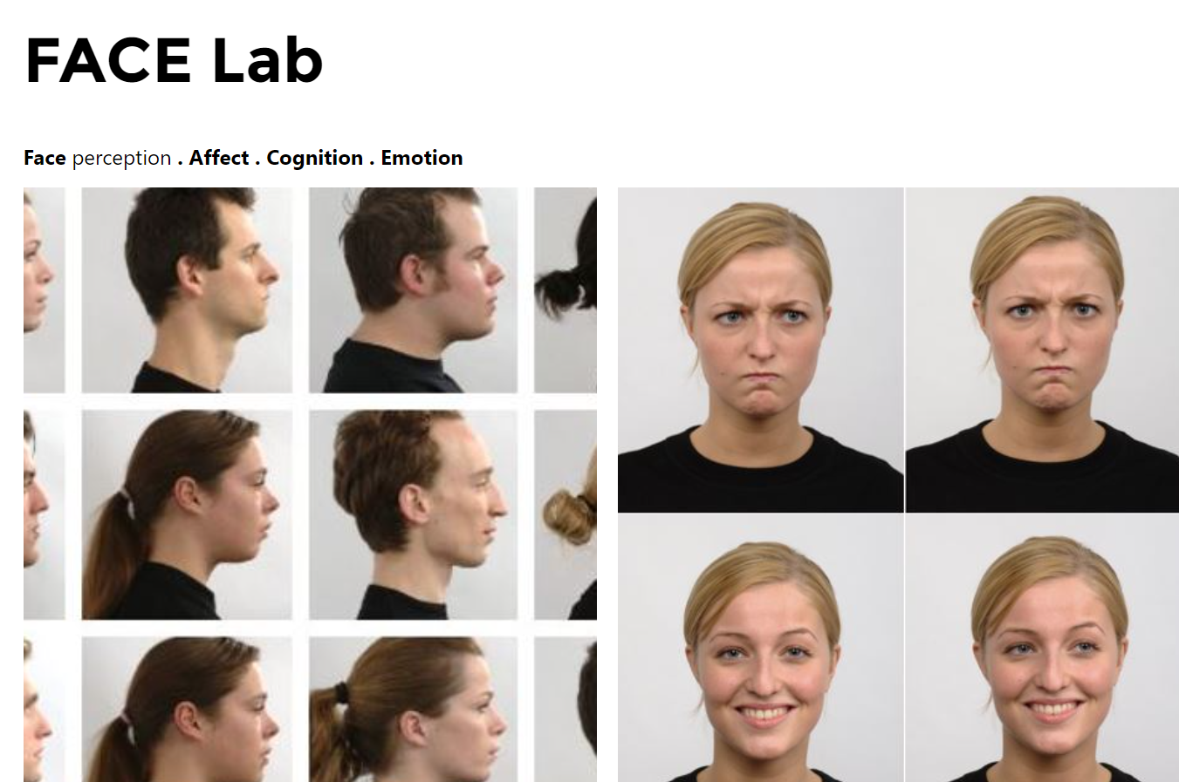
https://spectra.site.hw.ac.uk/face-perception-lab/

Slide 8
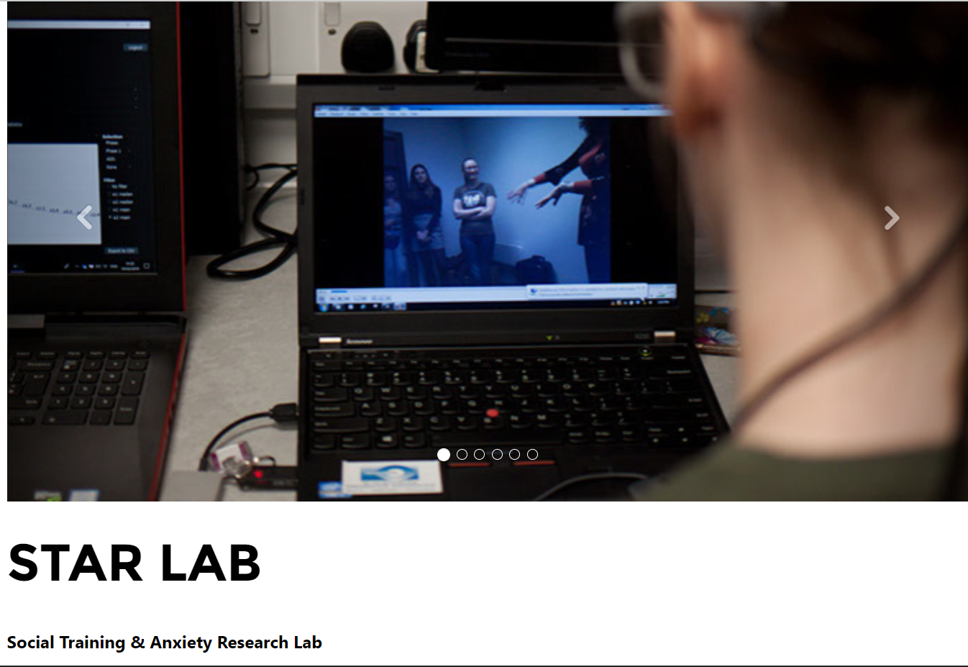
https://spectra.site.hw.ac.uk/star-lab/

Slide 9
MIND LABs Mental Illness & Neurodiverse Digital Labs
https://spectra.site.hw.ac.uk/mind-hub/

Slide 10
Digital mental health tools
Diagnosis
Mitigation
Treatment
Prevention of disease
(Torous, Stern & Bourgeois, 2022)

Slide 11
Digital Biomarkers

Slide 12
Digital Biomarkers - monitoring and mitigation
Smartphone data
Ecological Momentary Assessment (EMA)
Passive sensors
Artificial Intelligence (AI) – relapse prediction and anomaly detection
Only 1% of commercial apps use passive sensors and only 2% are supported by research evidence.
Natural Language Processing
Clinical remote monitoring (Torous et al., 2021)
Issues in objective metrics such as thresholds or movements
Adherence to protocols(Torous, Stern & Bourgeois, 2022)

Slide 13
Digital biomarkers for mental health
Proximity and walking behaviours
Dechant, Frommel & Mandryk (2021).
McKendrick & Delicato

Slide 14
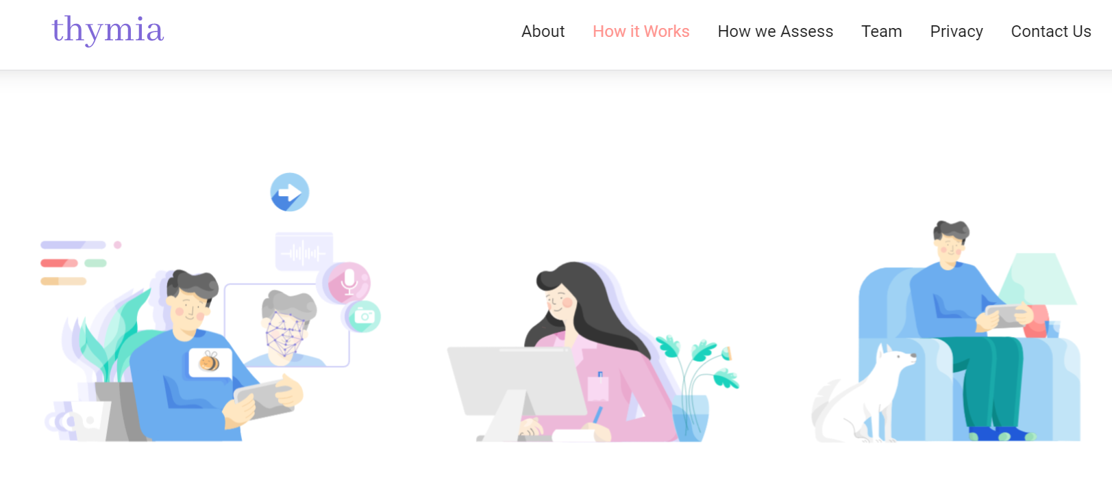
https://thymia.ai/

Slide 15
Digital biomarkers: Facial recognition
Ethics – Informed consent; bias, privacy (Martinez-Martin (2019)
“55.5% indicated they were equally worried about the privacy of medical records, DNA, and facial images collected for precision health research” (Katsanis et al., 2021)
Notes:
https://dot.la/apple-mental-heath-app-risks-2655206569.html

Slide 16
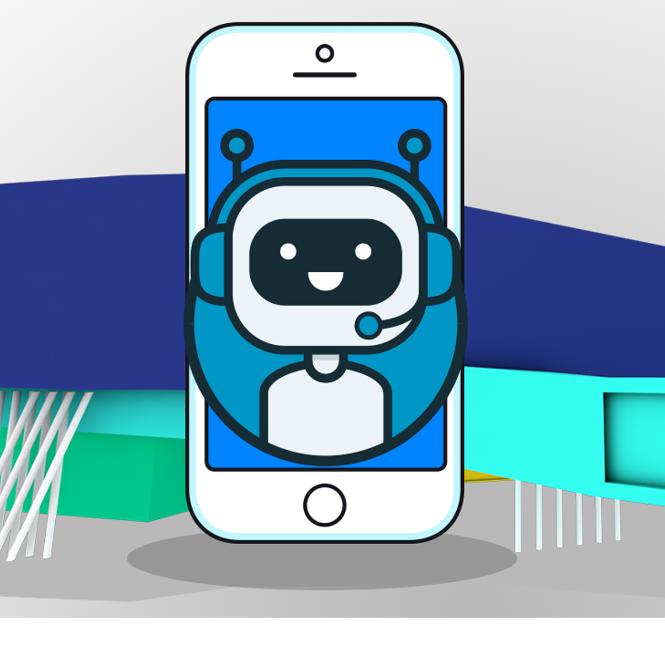
Digital interventions
Chatbots
Smartphones –information/health tips
Efficacy issues - only 55.3% mention evidence base and only 6.2% provided supported evidence.
(Torous et al., 2021)

Slide 17
Digital interventions: Virtual Reality
Shows promise (Torous et al., 2021)
Simsensei

Slide 18
Barriers to accessibility
Carnegie trust funded project

Slide 19
Child and Adolescent digital psychiatry
Advantages of digital tools
Disadvantages
Increased accessibility to healthcare
Treatment and mitigation
Autonomy/empowerment
User acceptance
Wies, Contantin & Ienca (2021)
Privacy/confidentiality
Perceived stigma
Inequity of access
Cross cultural differences
Clinical validation
Consent/dependancy

Slide 20
Digital interventions: Serious games

Slide 21
Potential issues in validation
Lack of control active groups
Overlapping conditions
Individual differences

Slide 22
SuperBetter
Engagement issues
95% of users disengage mental health-related apps within two weeks (Baumel et al. 2019)
In young people, risk of stigma

Slide 23
Engagement
Simplicity, fun, portable, accessible, affordable, varied…but which induce or reduce stress?

Slide 24
Regulation
Software as a medical device (SaMD)
FDA introduced the Digital Health Software Precertification (Pre-Cert) Pilot Program
FDA has cleared digital CBT programmes without clinical data (Torous, Stern & Bourgeois, 2022)
Privacy – e.g. 28% of Google play apps offer no privacy (Tangary et al., 2021)

Slide 25
Addressing the problems
Personalisation of digital biosensors to increase diagnostic accuracy – MIND Sense
Sophisticated cohort understanding - MIND Map
Therapeutic value– MIND Tools
Engagement/ Adherence - PPIs
Ethics – privacy, regulation – Development of protocols
Accessibility - Robotics
Validation - MIND Serve

Slide 26
Personalised Assessment MIND Sense

Slide 27
Cohort analysis MIND Map

Slide 28
Therapeutic Value Mind Tools

Slide 29
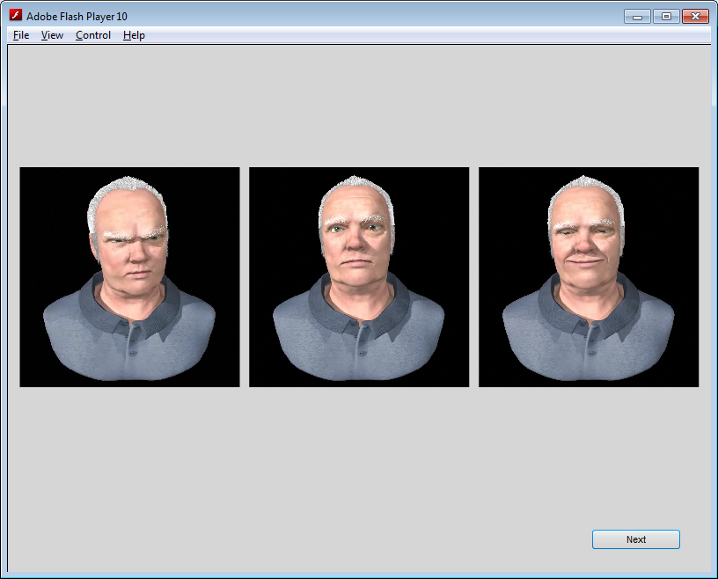
Pilot studies to build iterative understanding of mental health needs

Slide 30
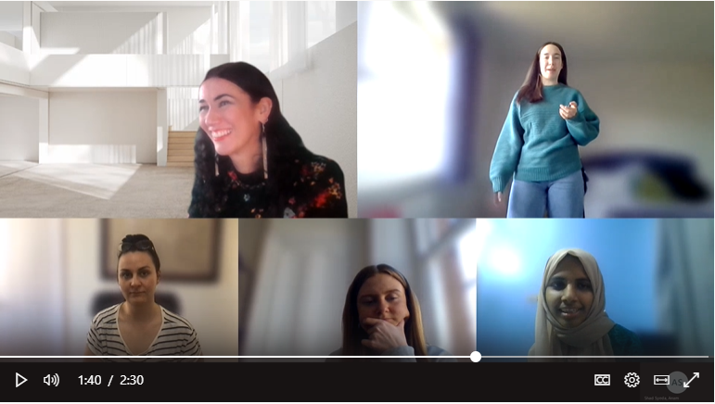
Therapeutic value
Trial intervention – validating mechanisms
Experimental group 1 (combined cognitive restructuring/exposure)
Experimental group 2 (exposure only)
Control group (performance only)

Slide 31
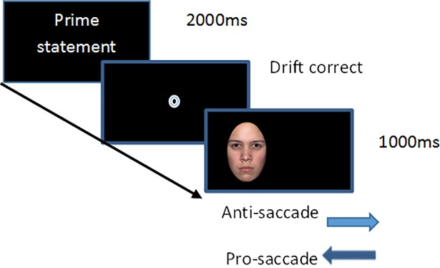
Digital biomarkers: Eye tracking
McKendrick, Butler & Grealy, 2016). l

Slide 32
Expert Performance Approach
An example of the expert performance approach(Ericsson, Krampe, & Tesch-Römer, 1993)

Slide 33
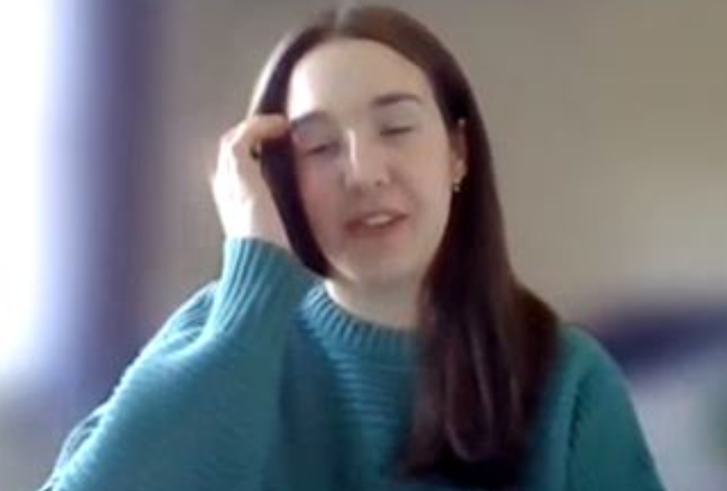
Digital Biomarkers Behavioural analysis

Slide 34
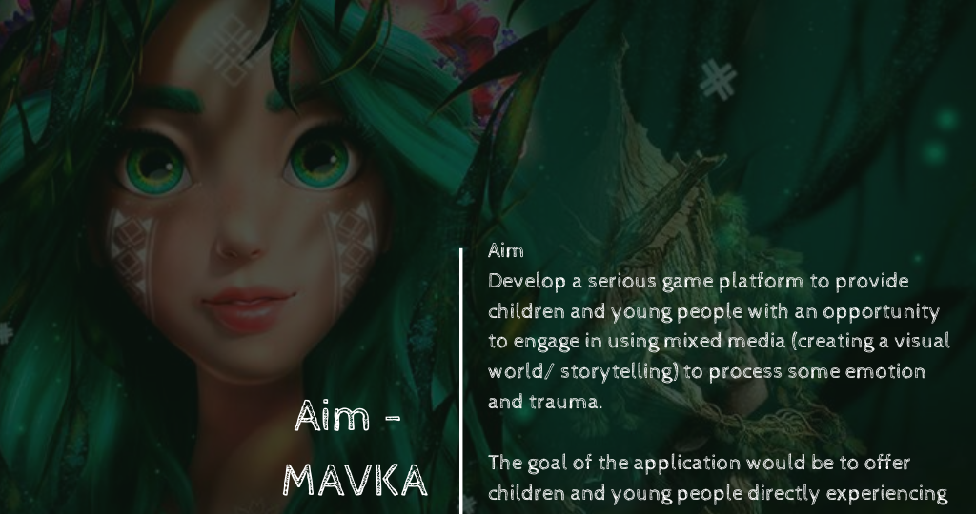
Engagement: PPIs

Slide 35
Ethics
SMILE
Ethics work package with advisory board
Privacy and security
Regulatory WP
User acceptance WP
Safeguarding WP

Slide 36
Validation MIND Serve

Slide 37
References
Baumel, A., Muench, F., Edan, S. & Kane, J. M. (2019) Objective user engagement with mental health apps: systematic search and panel-based usage analysis. J. Med. Internet Res. 21, e14567.
Dechant M.J., Frommel J., Mandryk R.L. (2021). The Development of Explicit and Implicit Game-Based Digital Behavioral Markers for the Assessment of Social Anxiety, Frontiers in Psychology, 12, DOI=10.3389/fpsyg.2021.760850
Katsanis SH, Claes P, Doerr M, Cook-Deegan R, Tenenbaum J.D, Evans B.J, Lee M.K, Anderton J, Weinberg S.M, Wagner J.K. (2021). A survey of U.S. public perspectives on facial recognition technology and facial imaging data practices in health and research contexts. PLoS One, 14;16(10), e0257923. doi: 10.1371/journal.pone.0257923.
Tangari, G., Ikram, M., Ijaz, K., Kaafar, M. A. & Berkovsky S. (2021) Mobile health and privacy: cross sectional study. BMJ. https://doi.org/10.1136/bmj.n1248.
Torous J, Bucci S, Bell IH, Kessing LV, Faurholt-Jepsen M, Whelan P, Carvalho AF, Keshavan M, Linardon J, Firth J. (2021). The growing field of digital psychiatry: current evidence and the future of apps, social media, chatbots, and virtual reality. World Psychiatry, 20(3), 318-335. doi: 10.1002/wps.20883. PMID: 34505369; PMCID: PMC8429349.
Torous, J., Stern, A.D. & Bourgeois, F.T. Regulatory considerations to keep pace with innovation in digital health products. npj Digit. Med. 5, 121 (2022). https://doi.org/10.1038/s41746-022-00668-9.
Tychsen L, Thio LL. (2021). Concern of Photosensitive Seizures Evoked by 3D Video Displays or Virtual Reality Headsets in Children: Current Perspective. Eye Brain, 12, 45-48. doi: 10.2147/EB.S233195. PMID: 32104130; PMCID: PMC7023866.
Wies, B., Contantin, L. & Ienca, M. (2021). Digital Mental Health for Young People: A Scoping Review of Ethical Promises and Challenges. Frontiers in Digital Health, 3. DOI=10.3389/fdgth.2021.697072

Slide 38
Opportunities Email: M.McKendrick@hw.ac.uk
Looking for participants for research study
Looking for help to integrate Pupil Core eye tracking to HTC Vive using Unity.
Thankyou!
Questions?

